Slide 1
The Hydrosphere
By: Alexandria,Ava W.,and Nick E

Slide 2
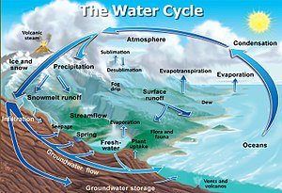
The water cycle
The water cycle is a process by which water moves through earth’s surfaces to the atmosphere and back. The factors that help the water cycle is the energy from the sun and gravity. The water moves through the geosphere, biosphere, hydrosphere,and the atmosphere.

Slide 3
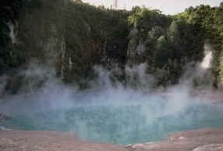
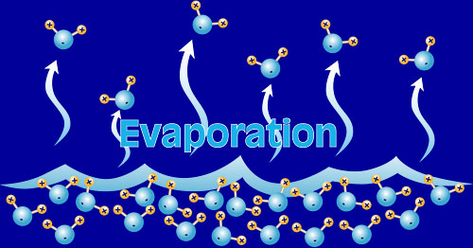
Evaporation
Evaporation is a process when molecules at a liquid’s surface absorb energy to change to gas. In evaporation, the sun heats up the surfaces of bodies of water and they give off water vapor. Water vapor can come from the geosphere and the biosphere. In the geosphere, water vapor can come from soil and in the biosphere, water vapor comes from animals when they breathe and off from our skin. Water vapor is also is also given off by leaves which is called transpiration.

Slide 4
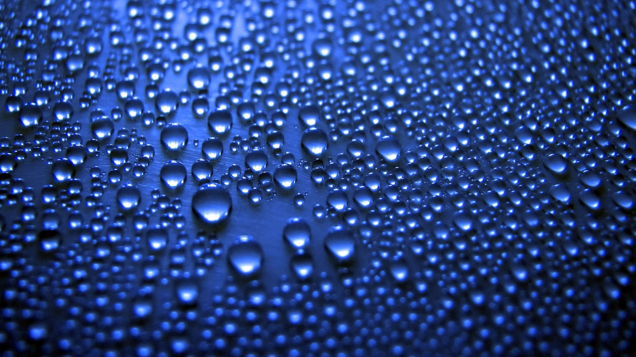
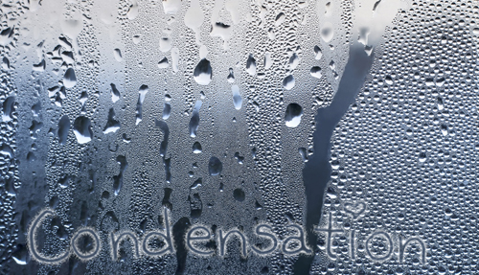
Condensation
Condensation is when water vapor condenses into colder air after it has evaporated. When the water vapor cools and condenses, liquid or solid water form. Those droplets of liquid water and ice crystals gather aroung solid particles which then forms clouds. This results in precipitation.

Slide 5
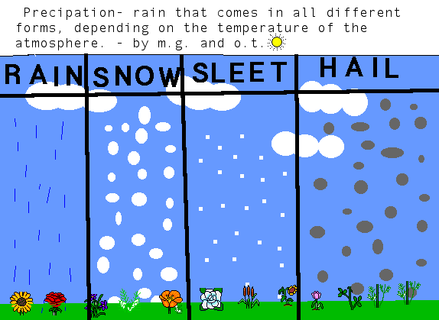
Precipitation
Precipitation is when water that forms in clouds comes down as rain, snow, sleet, or hail. The more water vapor that condenses, the larger the droplets and crystals grow. When they get to heavy they fall back to earth as forms as precipitation.

Slide 6
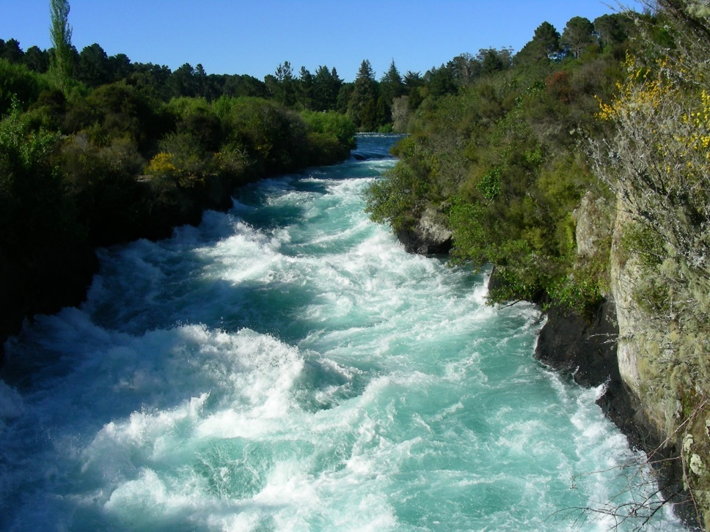
Rivers
A river is a trickle of water that comes from a sorce.Those sorces can be a underground stream, runoff, or melted ice and snow. Gravity plays a part in rivers.Gravity causes rivers to go downhill, flow into oceans, or join together. Tributaries feed into a main river and when they flow with rivers, a river system forms.

Slide 7
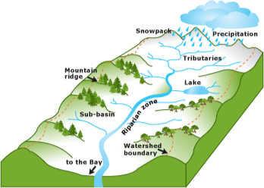
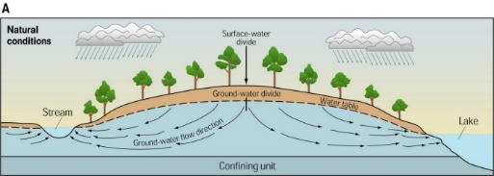
Watersheds and Divides
Watersheds
Divides
Watersheds are rivers that join a river system. The area drains and become part of the largest river’s watershed.
A divide is a piece of lane that separates watersheds from each other. The streams on each side of the divide flow in different directions.

Slide 8
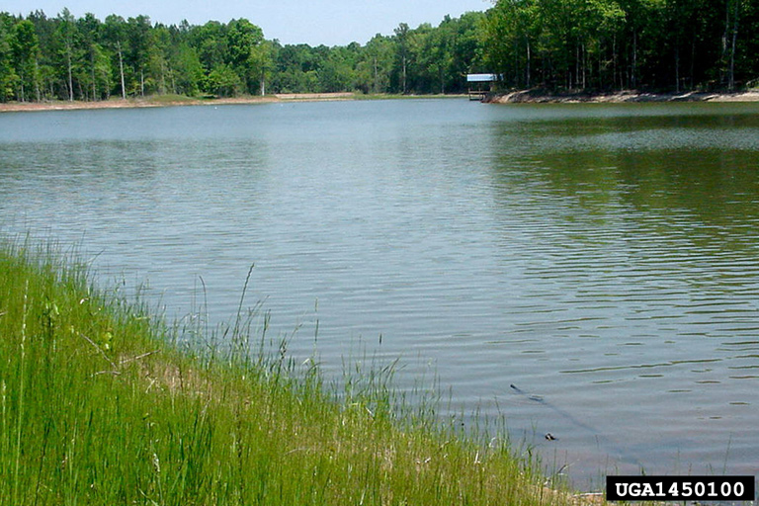
Ponds and Lakes
Lakes form when a river bends. Other lakes form when Earth’s crust forms long and deep valleys. They may also form in craters.
Ponds and lakes form when waters gathers in low areas of land. Ponds and lakes are supplied by rain, melting ice/snow, and runoff. Some are supplied by groundwater.

Slide 9
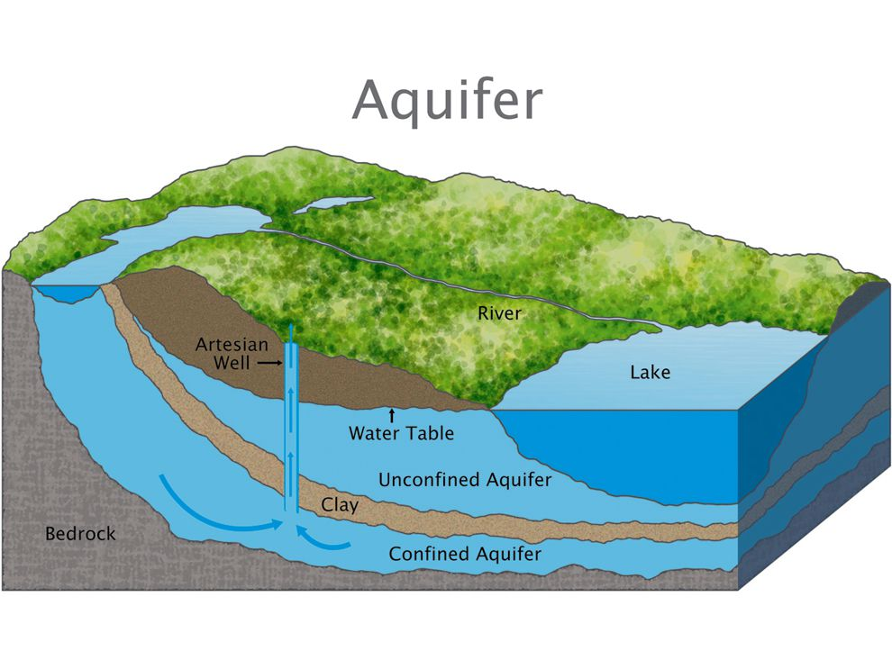
Aquifers
When precipitation fall, it seeps through spaces between underground rock layers. The layers that aren’t saturated contain air and water. The layers that are saturated contain water only. This filters the water and provides 55 percent of drinking water.

Slide 10
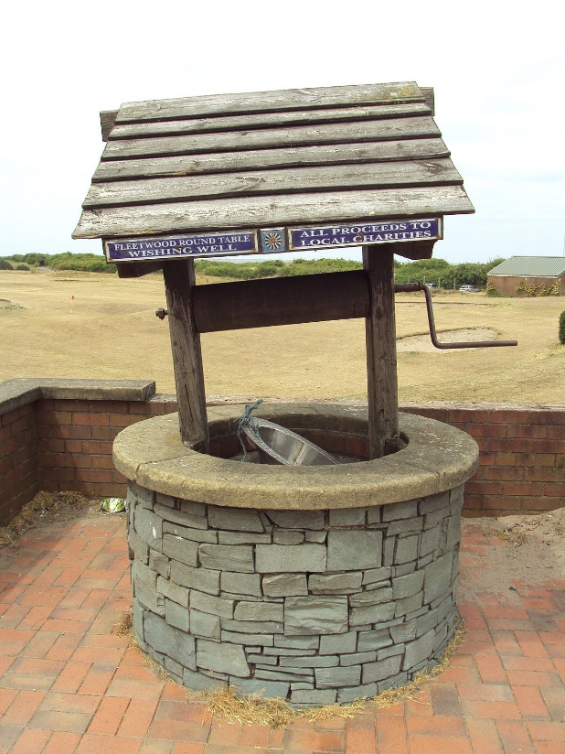
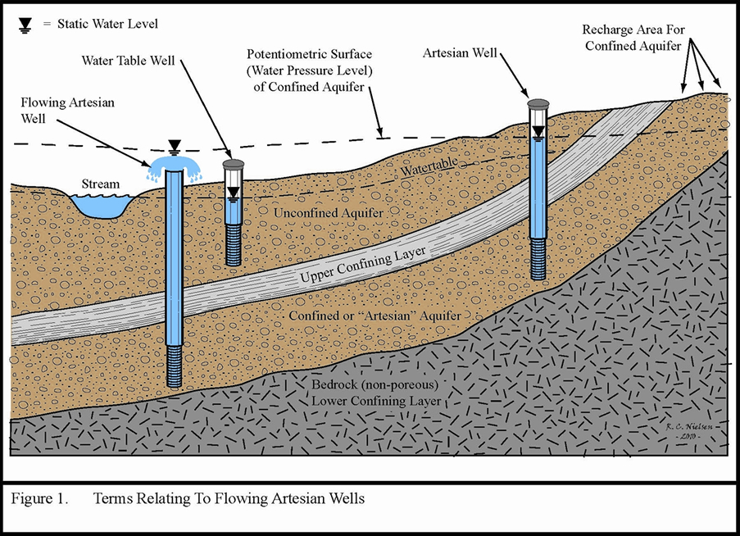
Wells
A well is a hole dug into the ground that reaches a water source. Long ago people got their water from wells and we still use them today.

Slide 11
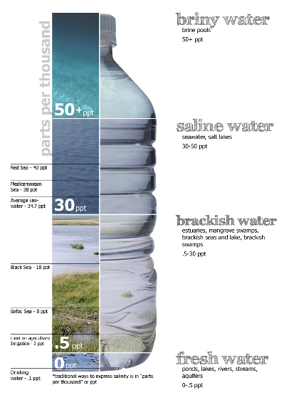
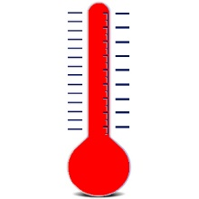
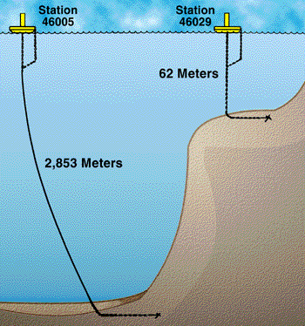
Salinity, Temperature, and Depth
Salinity is amount of dissolved salt in an amount of water. When freshwater is added to the ocean, its salinity decreases.
The surface of the ocean absorbs the sun’s energy. The equator manages the ocean’s temperature. At the equator, water is room temperature. Temperatures drop as you near away from it.
As you go deeper into the ocean, temperature drops. Water pressure increases every 10 meters as well. Depth can affect these factors.

Slide 12
Ocean Features
Some of the ocean’s features are seamounts, trenches, cintinental shelves, continental slopes, abyssal plains, and mid ocean ridges.

Slide 13
Earth’s Water

