Slide 1
The Hydrosphere
By: Sophia, Ryan, Andrew, & Kayla

Slide 2
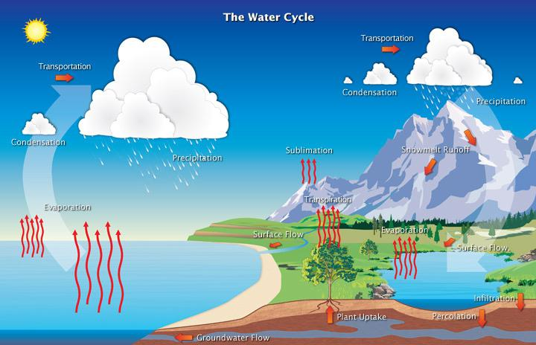
What is the Water Cycle?
The water cycle is the continuous process that Earth uses to recycle water, it has three steps.

Slide 3
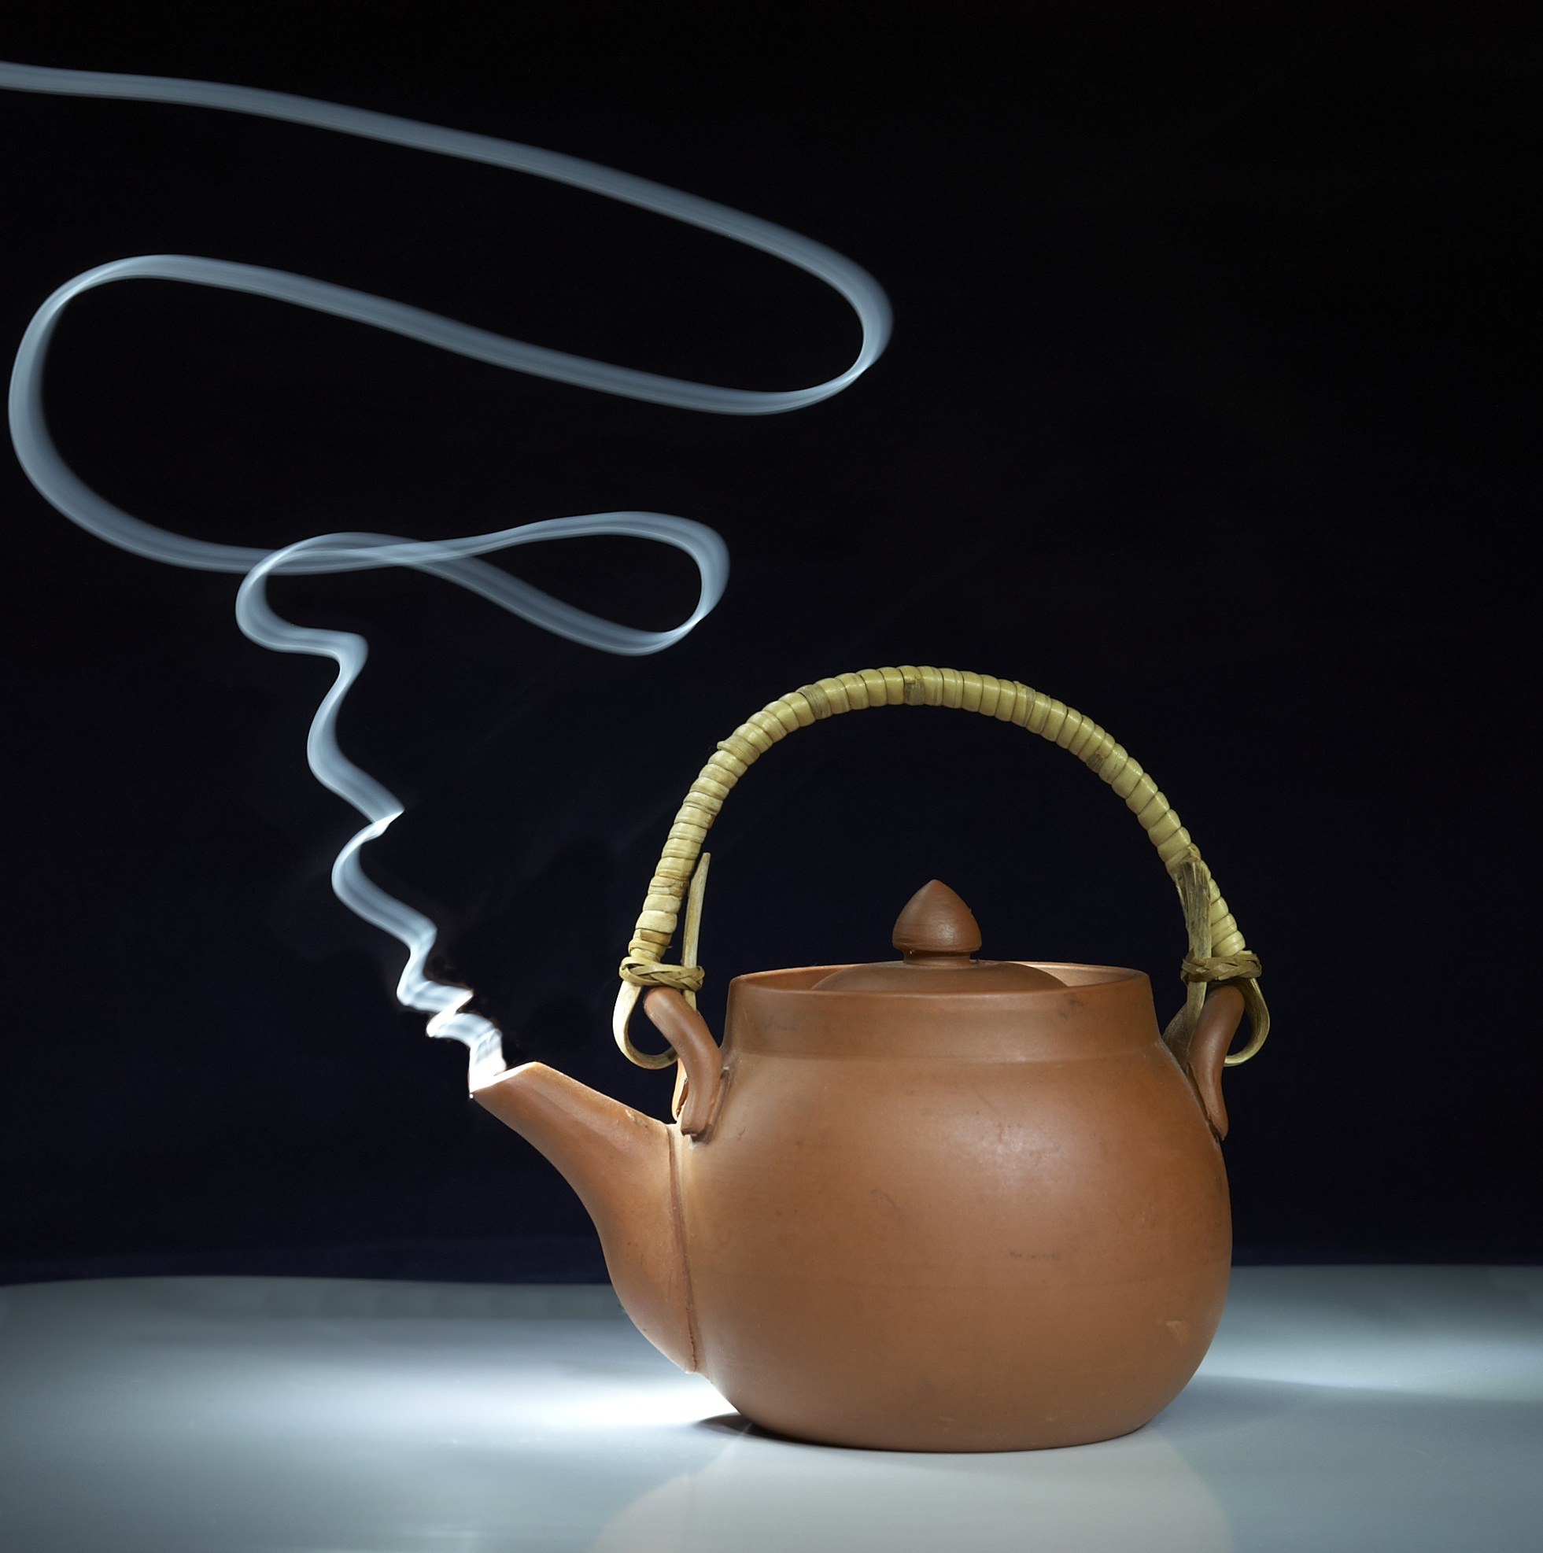
Step One: Evaporation
Evaporation occurs when the sun heats up water and causes the molecules to change into a gas this is constantly happening. There is also transpiration when plants give off water through their leaves.

Slide 4
Step Two: Condensation
Condensation happens when water vapor rises into cold air it condenses into cold air and becomes liquid or solid water. The particles and droplets surround solid particles in the sky to form clouds. This will eventually become precipitation.

Slide 5
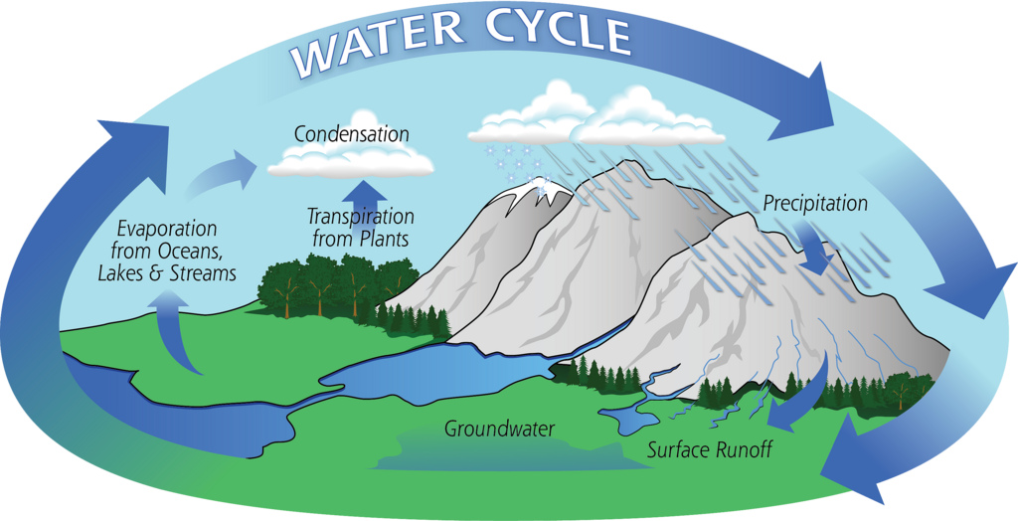
Step Three: Precipitation
Precipitation occurs when clouds get too heavy, then gravity pulls the clouds down and then it causes rain, snow, hail, or sleet. This precipitation gets gathered in streams, lakes and rivers.

Slide 6
Distribution of Earth’s water
Distribution of Earth’s water on Earth’s surface is extremely uneven.Only 3% of the water on the surface is freshwater. 97% of the Earth’s water is saltwater. 69% is in glaciers.30% remains underground,and then 1% is located in lakes rivers and swamps.

Slide 7
Surface Water
Surface water is the water on the surface of earth the ocean, rivers, lakes, and ponds are all examples of Earth’s surface water.

Slide 8
Rivers
A River is a medium sized body of water but it naturally flows the water in the river.It Is usually always fresh water flowing through the river.And it is usually made by a small stream running down a mountain side and it keeps on cracking until it gets large and large and then it can be required as a river.

Slide 9
Watersheds
Land that supplies water to a river system is a watershed. When rivers join the drained areas become part of the largest river’s watershed.

Slide 10
Divides
Streams on each side divide and flow in different directions. For example, Water flows into the Mississippi River and into the Gulf of Mexico.

