Slide 1
The Geosphere
By: Anna, Alexa and Quinn

Slide 2
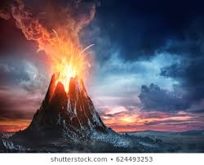
What is topography?
Topography is the way of piece of land is shaped. All of the seven continents have different topographies.

Slide 3
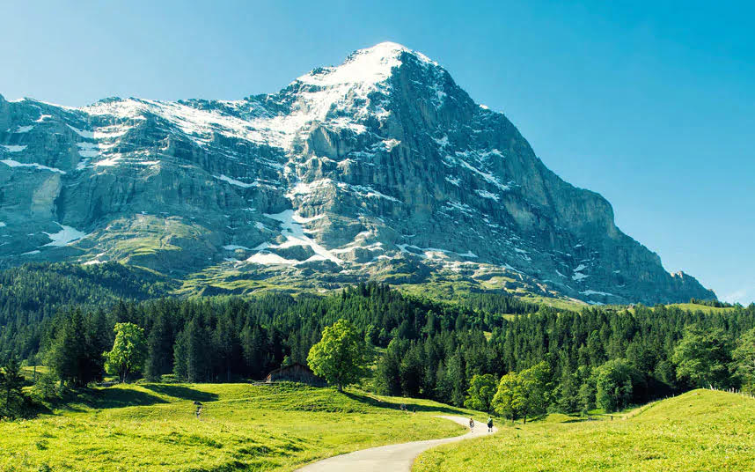
What is a landform?
A landform is a mountain, but consists of more. A landform includes coastlines, dunes, and mountains.

Slide 4
Highest and Lowest points of Elevation
The highest point of elevation is Mount Whitney. The lowest point of elevation is Badwater Basin. Elevation means how tall and far something is from the or ground.

Slide 5
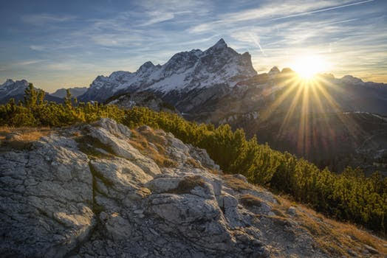
What is a mountain?
A mountain is a type of landform that has both high elevation and relief. Relief is the difference between the highest and lowest points of elevation.

Slide 6
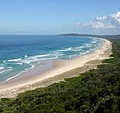
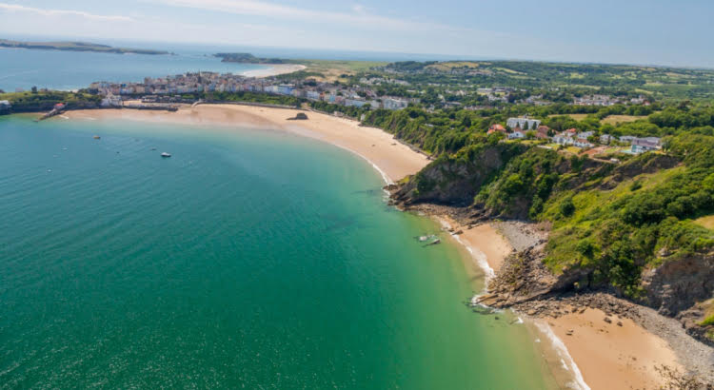
What is a coastline?
A coastline is the boundary between land and water or where land and water meet.

Slide 7
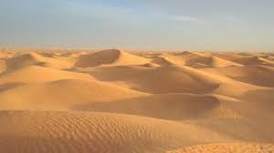
What is a dune?
A dune is a mountain like form created by sand that is shaped by the wind.

Slide 8
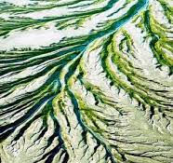
What is delta?
For a delta to happen sediment has to build up creating a type of landform we know as a delta.

