Slide 1
Surface Features in the Geosphere
By: Adam, Aubrey, Cassidy, Evan

Slide 2
Vocabulary
Topography- A shape of land.
Landforms- Features such as coastlines, dunes, and mountains.
Mountains- A landform with both high elevation and high relief.
Coastline- The boundary between the land and the ocean or a lake.
Dune- A hill of sand piled up by the wind.
River- A natural stream of water that flows into another body of water such as an ocean, lake, or another river.
Delta- When sediment builds up.

Slide 3
Understanding the geosphere
The Geosphere is the sphere of landforms. There are many landforms like dunes, coastlines, mountains, plateaus, rivers, and volcanos. The Geosphere is very unique compared to the other spheres beacuse it makes up the crust of the earth. Erosion and weathering also help create the Geosphere. It helps because it creates dunes by lifting sand and it piles on top of eachother. It creates delta by breaking up sediment and laying them on top of eachother. It creates canyons, by water carving into the sand and rock, and creates this giant landform.

Slide 4
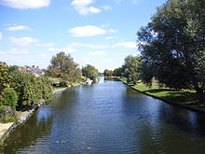
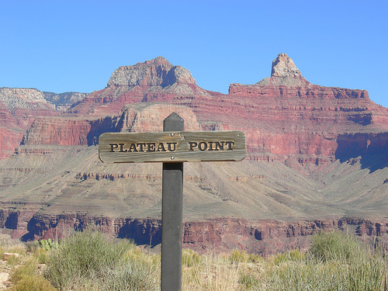
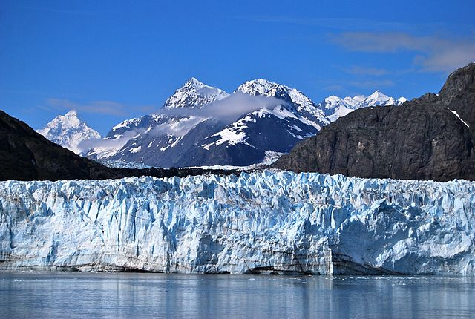
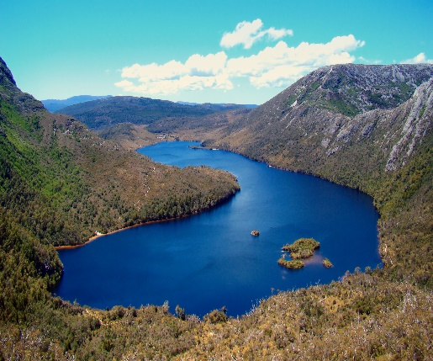
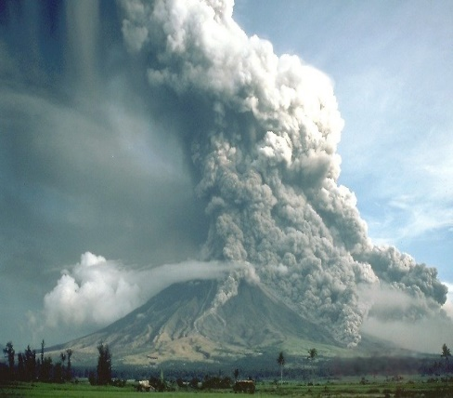
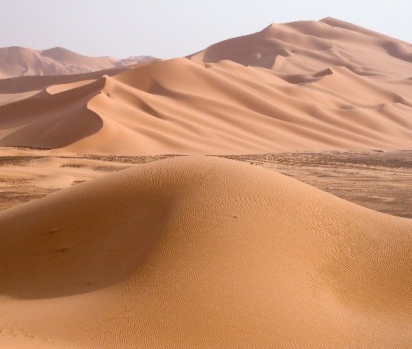
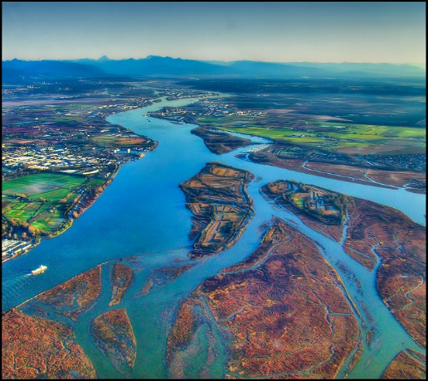
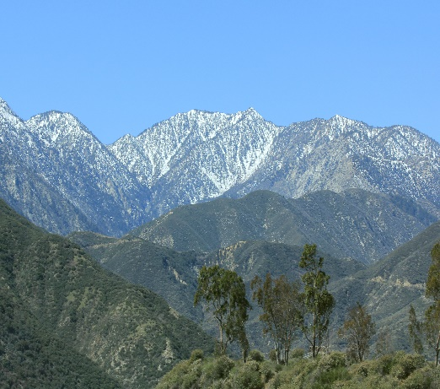
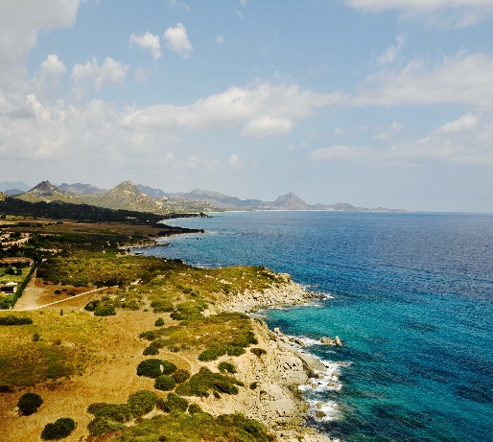
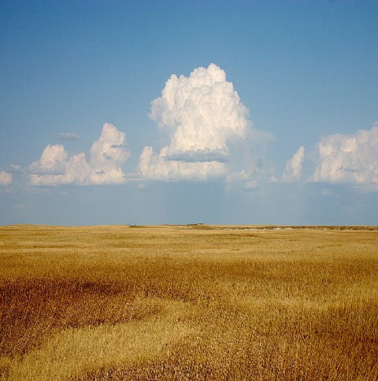
The landforms of the geosphere
There are many landforms in the Geosphere, Everyone is made unique. For example, a Delta is when sediment piles up on top of eachother to make an island like form in a lake. A Dune is made by wind carrying sand and piling on top of eachother to make a hill of sand.

Slide 5
Q and a
Question: What is a Delta
Answer: When sediment builds up in water
Question: What are three different surfaces in the Geosphere
Answer: River, Plateau, Glaciers, Lakes, Volcanos, Dunes, Deltas, Mountains, Coastlines, or Plains
Question: What state has the longest Coastline
Answer: Alaska

