Slide 1
Our Science Project ☺
BY: alexa castillo-mack, Bella Scherlis, emma hallett, Isabella Conroy, and tucker haley

Slide 2
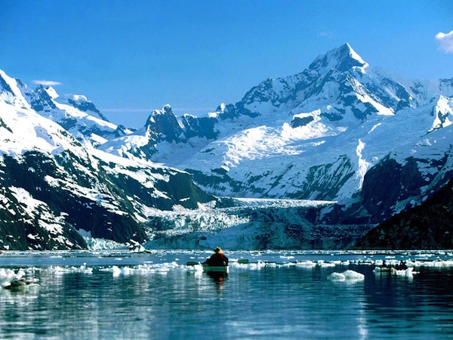
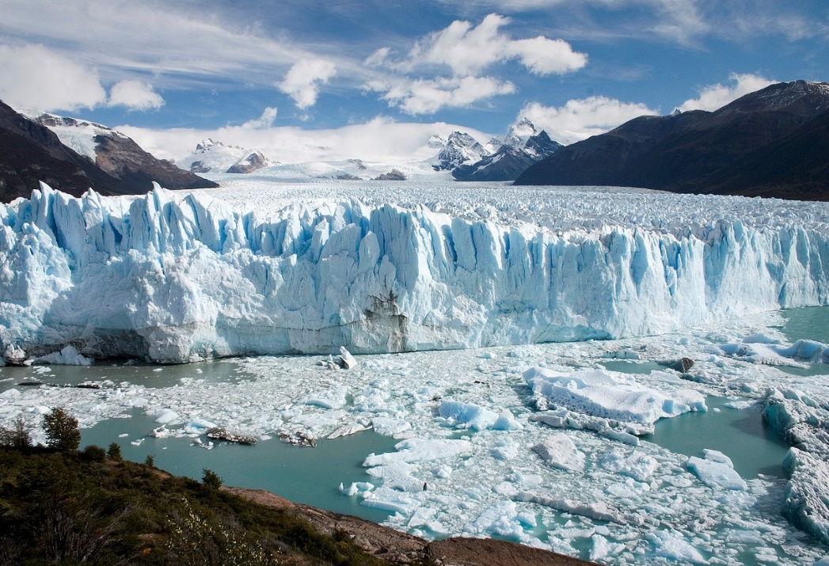
How do glaciers change Earth’s surface?
A glacier’s weight and movement can change the Earth’s land and reform it throughout hundreds of years. The ice from the glacier reshapes the surface by carrying broken rocks and soil from their original position, which changes the land.

Slide 3
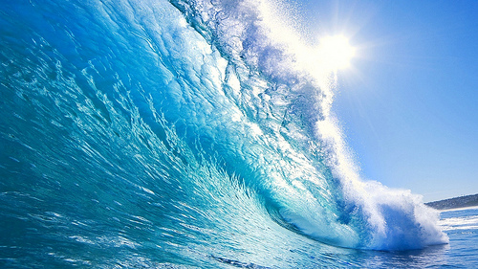
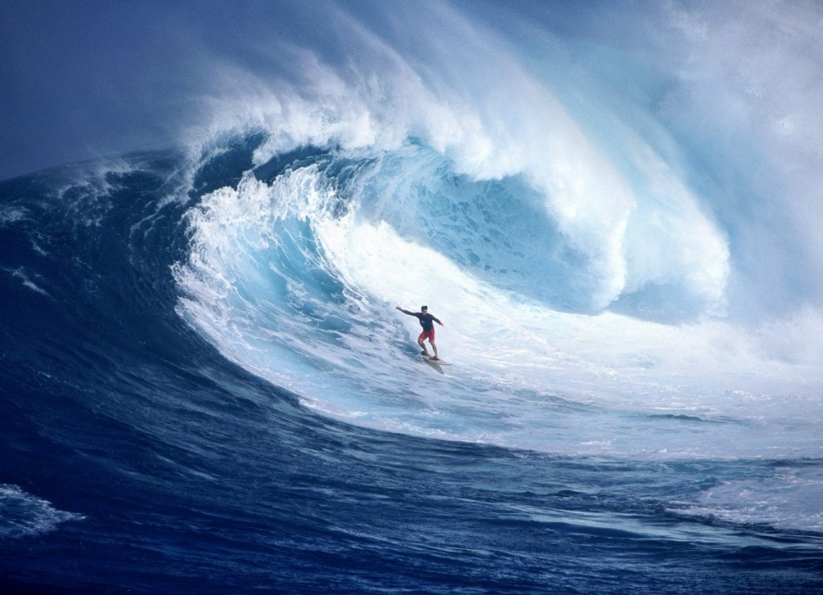
How do waves change Earth’s surface?
Waves change Earth’s surface when they crash onto the shore. Whenever waves crash onto the shore, they drag sand, rocks, and other materials with the water, and transport them to other areas of the beach and deposit them in other places, which can form and destroy landforms.

Slide 4
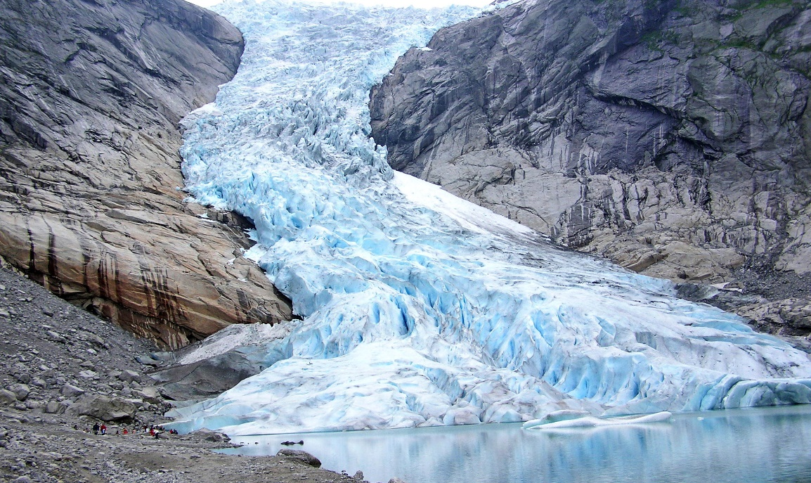
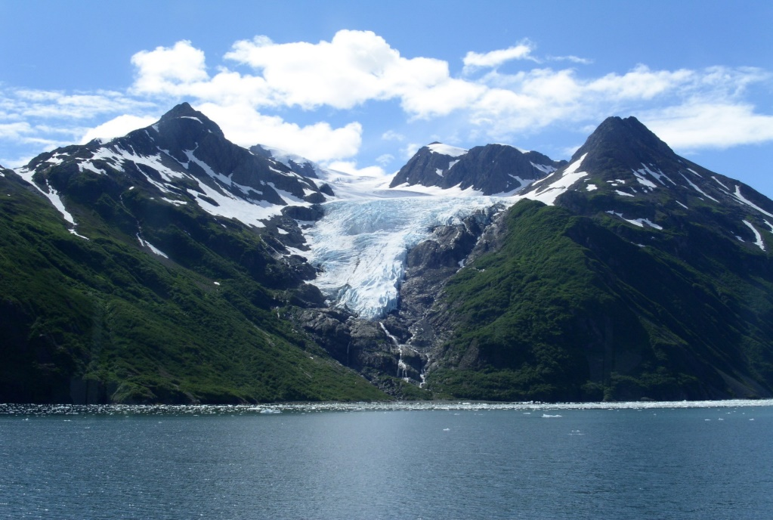
What is glacial erosion?
Glacial erosion is the sliding of the glacier and the meltwater freezing in the cracks of rocks underneath the glacier. The meltwater freezes in the cracks of rocks, melt, and are pried loose, which causes glacial erosion.

Slide 5
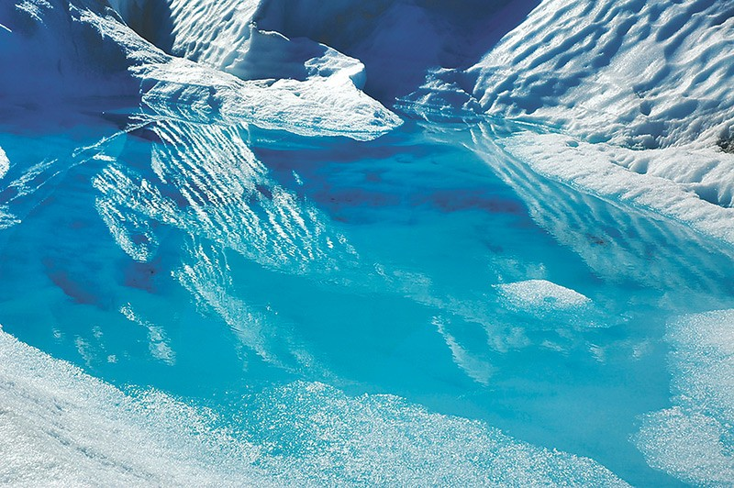
What is glacial deposition?
Glacial deposition is the settling of sediments left behind by a moving glacier. As glaciers move over the land, they pick up sediments and rocks. The mixture of unsorted sediment deposits carried by the glacier is called glacial till. Piles of till deposited along the edges of past glaciers are called moraines.

