Slide 1
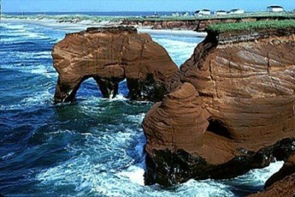
Science Project
By:Evan,Newman,Quinn,and Ryan

Slide 2
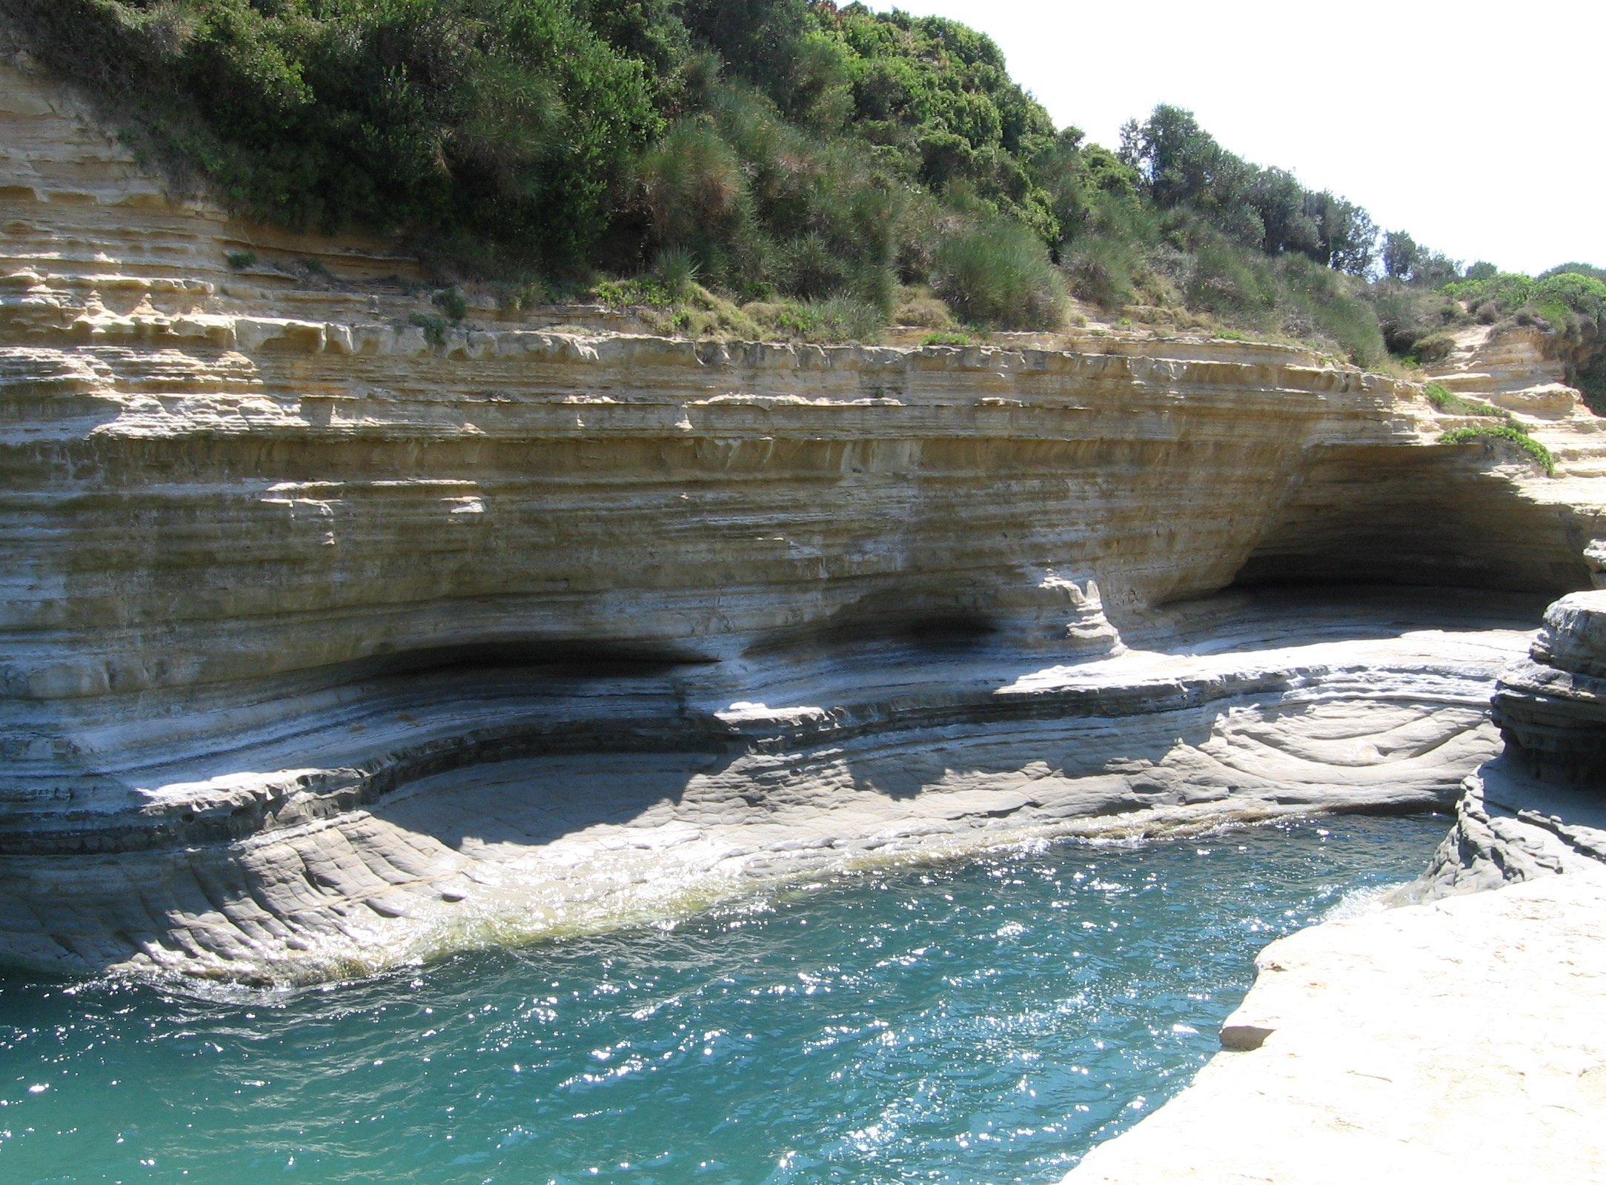
How Can moving water change Earth’s surface?
Moving water changes Earth’s surface by eroding rocks.

Slide 3
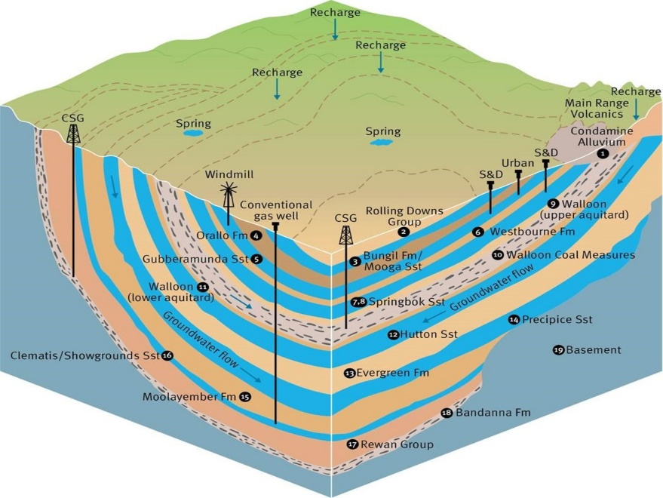
How does Groundwater change Earth?
Groundwater changes Earth by giving us fresh water and trees fresh water so we get oxygen.

Slide 4
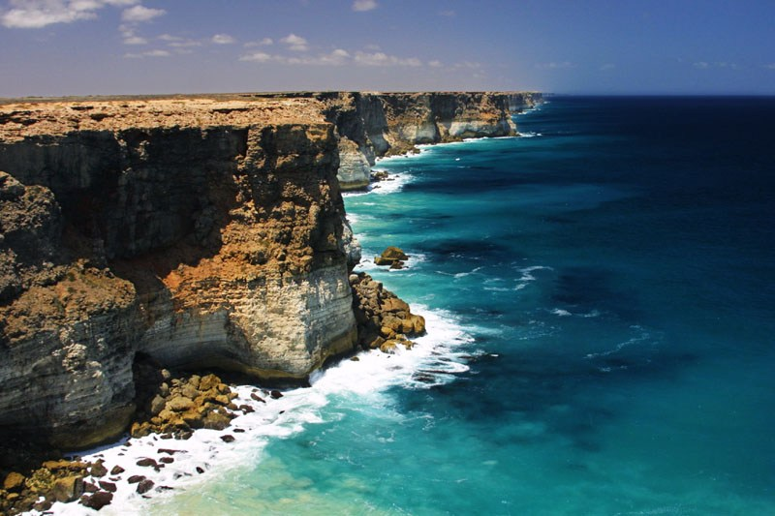
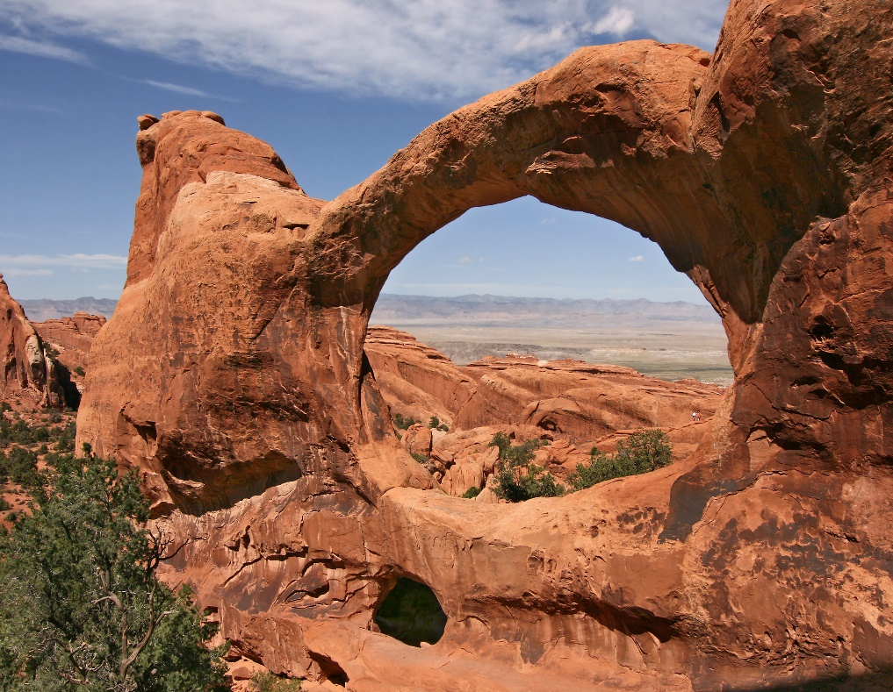
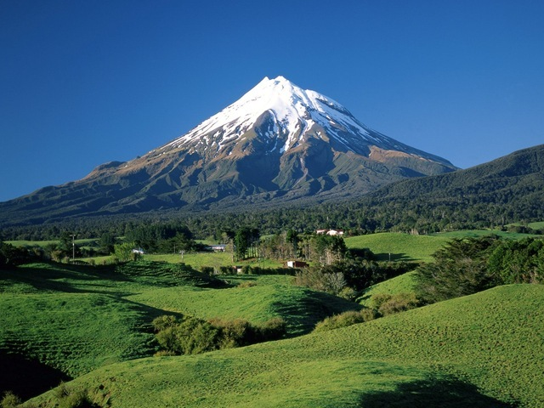
What types of Landforms are formed from Erosion?
The Landforms that are formed by Erosion are Arches, Mountains, and Coastlines.

Slide 5
