Slide 1
Earths Erosion and Weathering
By: Brayden, Adam, Ben, Josh, Anthony and Jaden

Slide 2
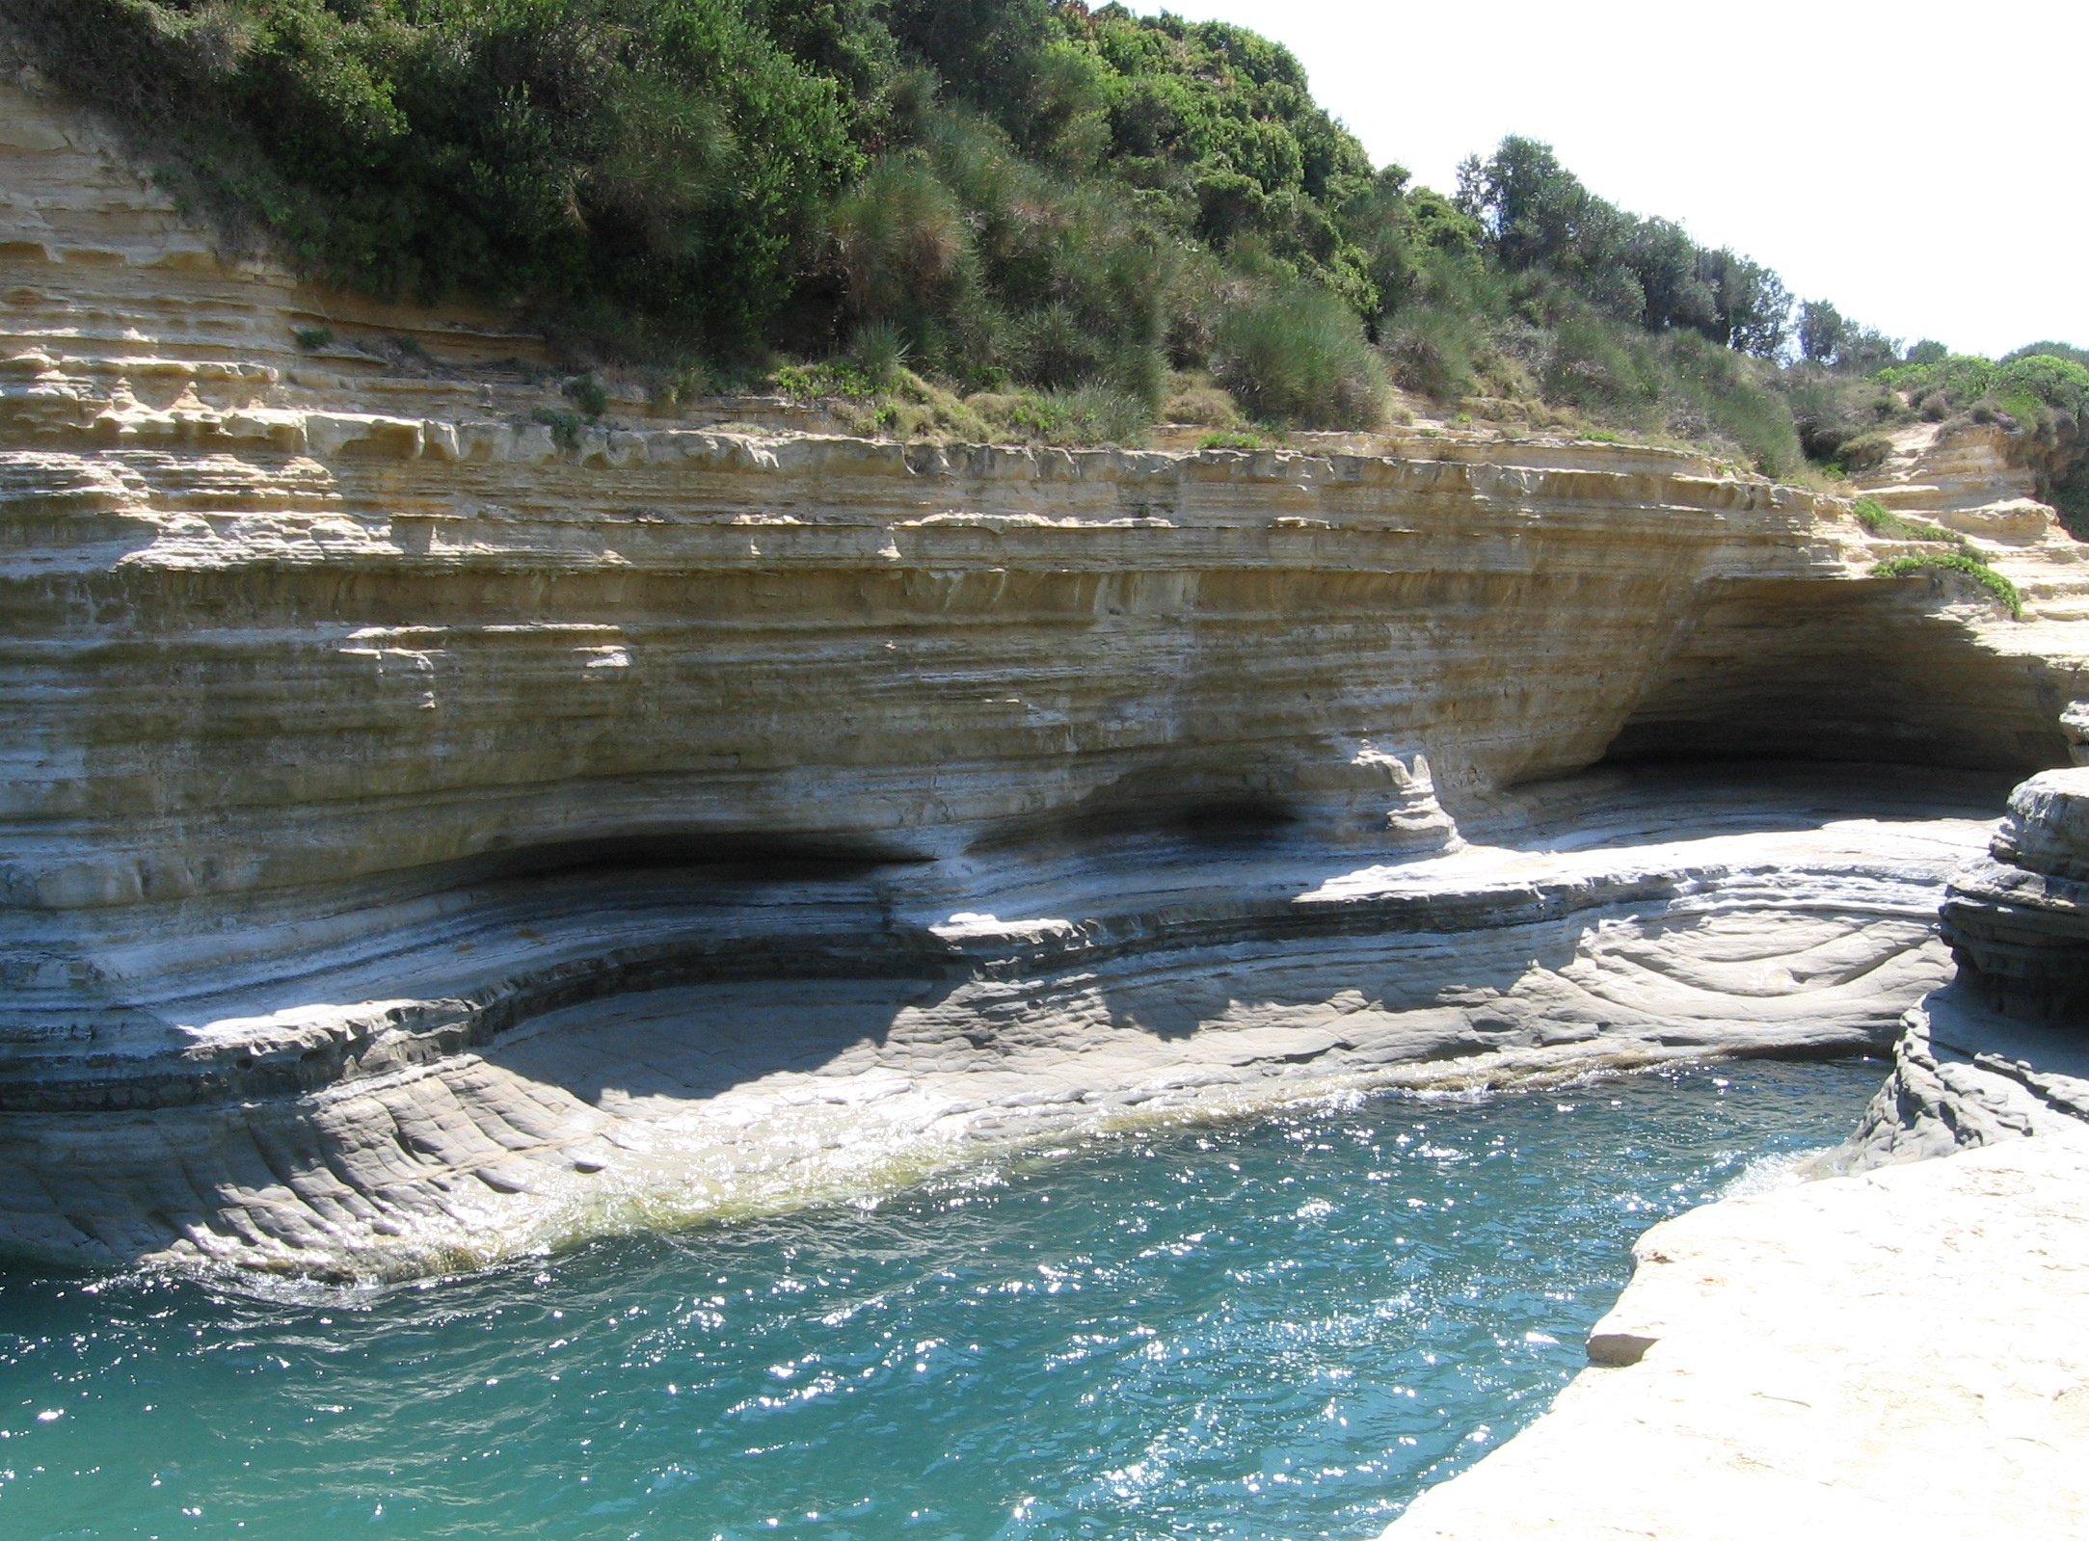
How does Erosion change Earths surface?
Erosion can change Earth’s surface by wearing down and carrying away rock particles. As seen in the image the water over a very long period of time has smoothend and shaped the rocks for constantly rubbing up against the rock. Their are other ways that format

Slide 3
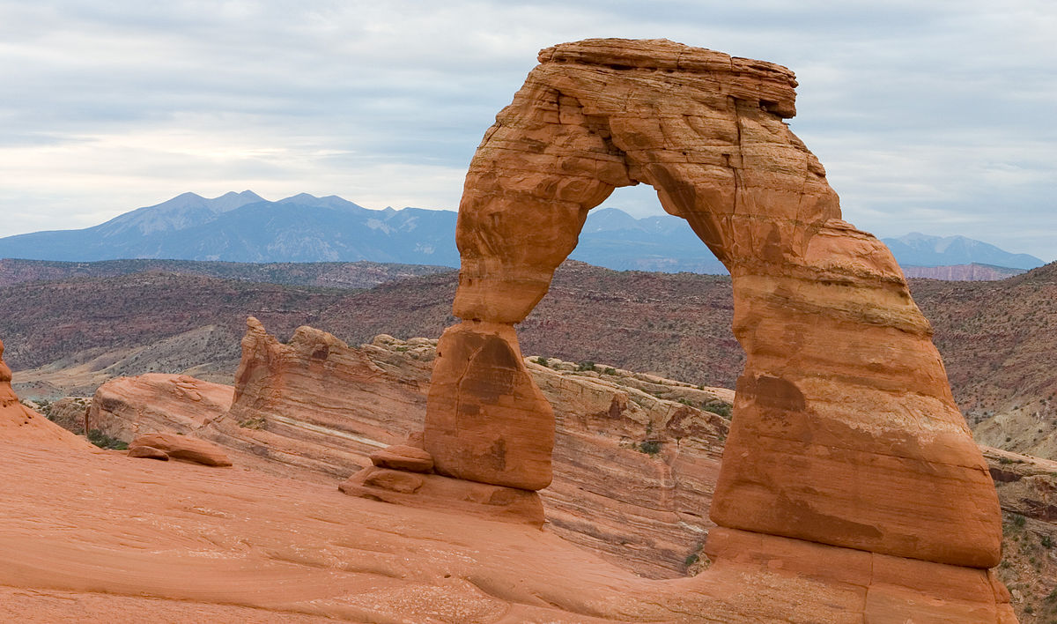
How does weathering Change Earth's surface?
Weathering changes Earth's surface by breaking down rock and other substances, some examples of this are heat , cold,water,ice and gases. Weathering rocks and other things on Earths surface can also cause rocks to change their overall look.

Slide 4
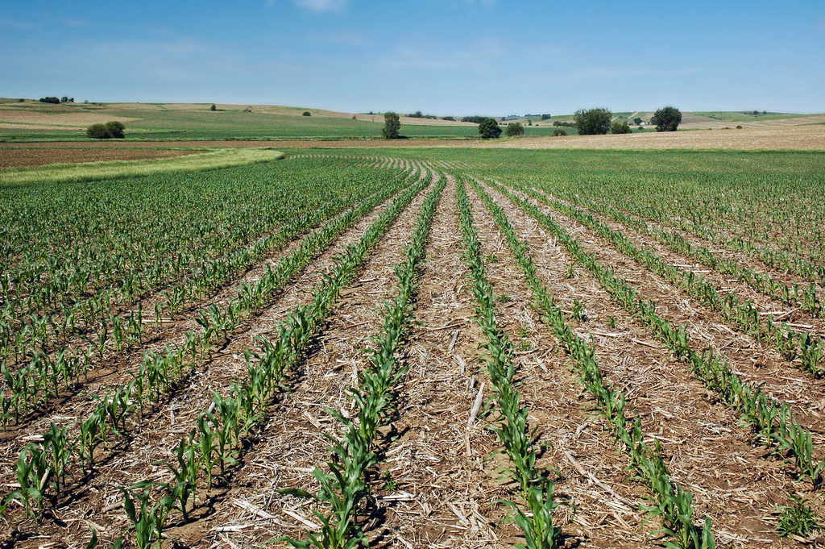
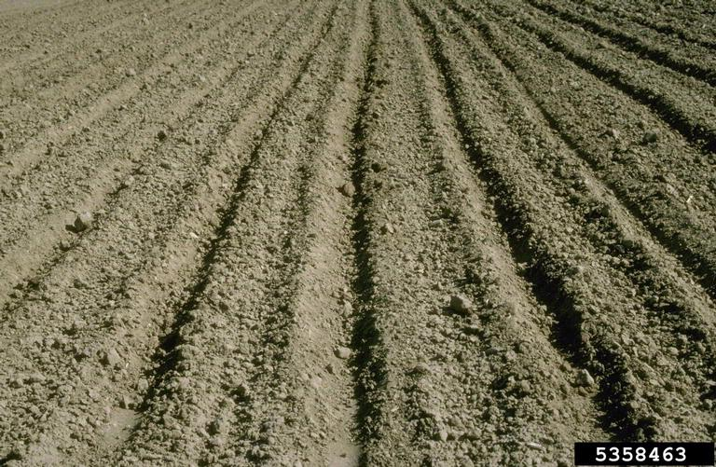
How does soil form?
Soil is part of a layer of different materials in the Earth and on the surface. Soil is formed when rocks such as bedrock is broken down and weathered, the soil contains air, water, and decomposed animals which is all organic material.

Slide 5
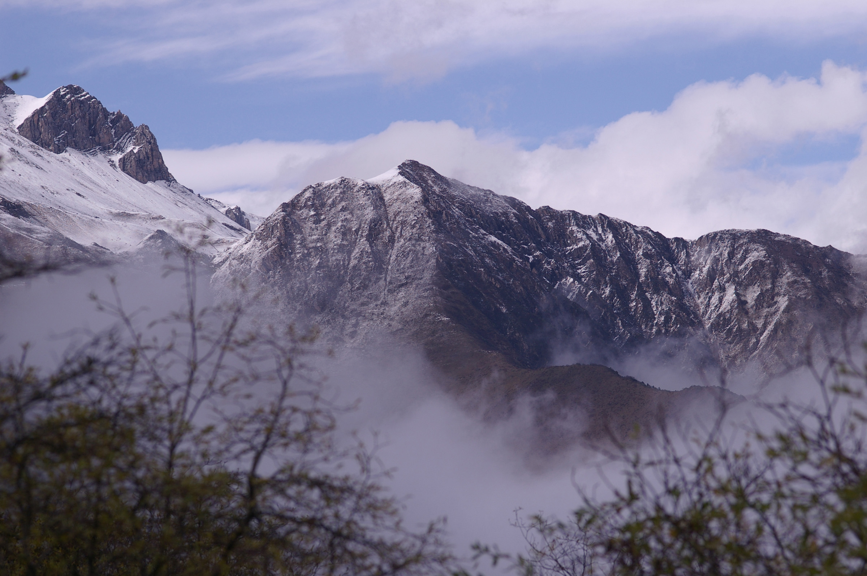
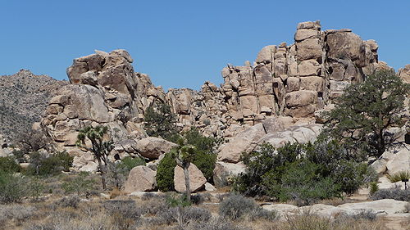
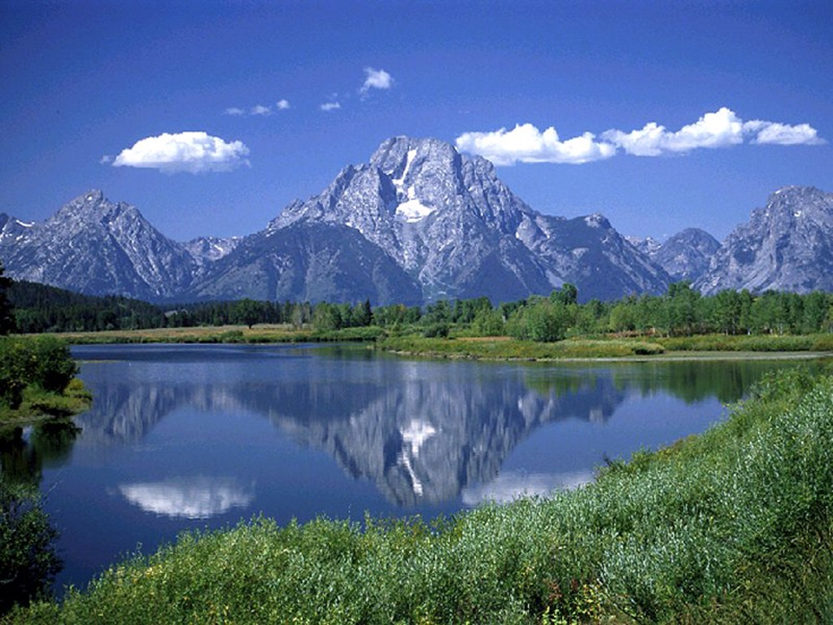
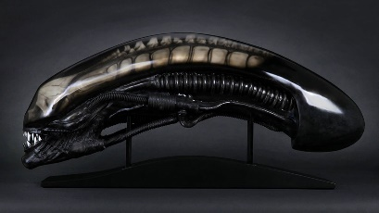
What is mechanical weathering?
Mechanical weathering is when rock is physically broken into smaller pieces. A difference in tempurature in the day and night can cause the rocks to get bigger and to get smaller, this can cause the rocks to break and crack.

Slide 6
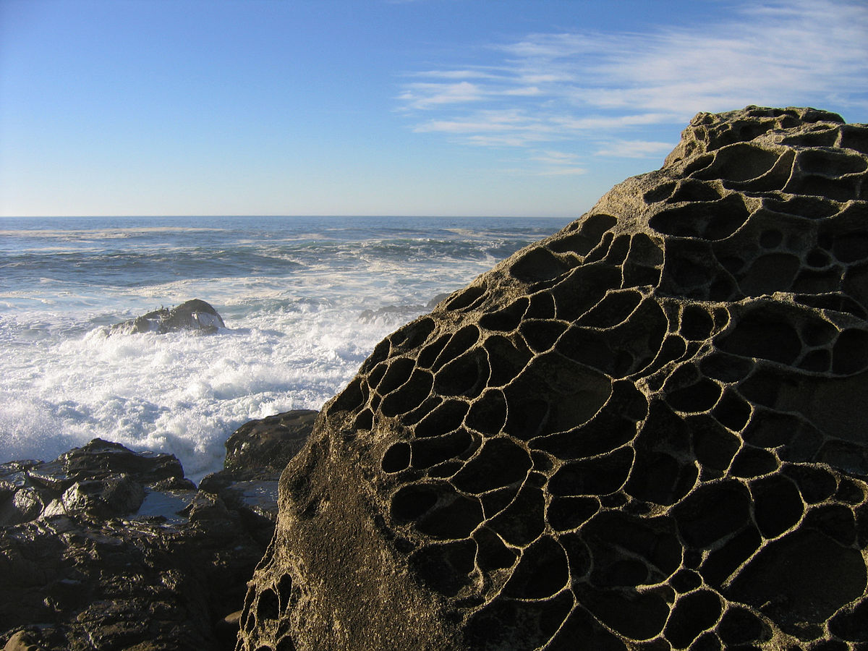
What is chemical weathering?
Chemical weathering is the process that breaks down rock through chemical changes. Elements in nature that can cause chemical weathering are acid-rain, water, oxygen, and carbon dioxide.

Slide 7
https://www.pearsonrealize.com/community/program/07a3b56e-1252-370e-9a03-c2c6f589bb46/15/tier/8971390b-f1bb-3002-888c-65af6e9a2ea1/15/lesson/ce42612c-0f28-34b6-940a-8813d7b99e68/15/content/629807ae-3121-31ad-9958-9ac6e5ee9c57/17

