Slide 1
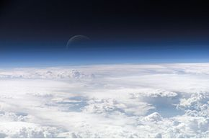
Matter and Energy in Earth’s System
By: Bella, Joey, Emma

Slide 2
Vocabulary
Atmosphere – The relatively thin layer of gases that forms Earth’s outermost layer.
Geosphere – The densest parts of Earth, including the crust, mantle, and core.
Hydrosphere – The portion of Earth that consists of water in any of its forms, including oceans, glaciers, rivers, lakes, groundwater, and water vapor.
Cryosphere – The portion of the hydrosphere that is frozen, including all the ice and snow on land, plus sea and lake ice.
Biosphere – The parts of Earth that contain living organisms.

Slide 3
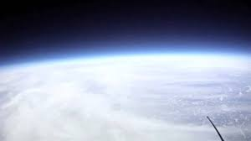
Atmosphere
The atmosphere is a thin layer that has all of the gas that we need to survive. The gases are nitrogen, oxygen, carbon dioxide, and water vapor, and includes dust. Oxygen is in the air and it is what we breathe. The atmosphere is home to all of Earth’s weather and climates, including wind patterns, clouds, and other weather systems. The atmosphere is layered, and part of it called the ozone layer absorbs sunlight and protects us from harmful rays.

Slide 4
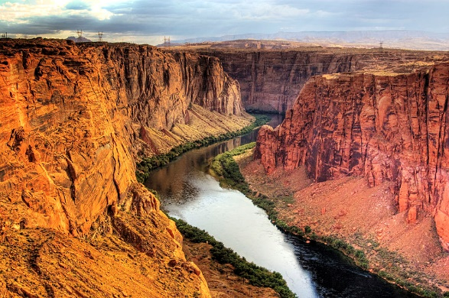
Geosphere
All of Earth’s rocks, minerals, and metals make up the geosphere. The core of the Earth, and the layers including the mantle and crust. The geosphere absorbs some heat and circulates it back to the atmosphere. It holds a lot of energy and matter which can also become dangerous, as it holds volcanoes and earthquakes, and can affect the atmosphere, hydrosphere, and biosphere.

Slide 5
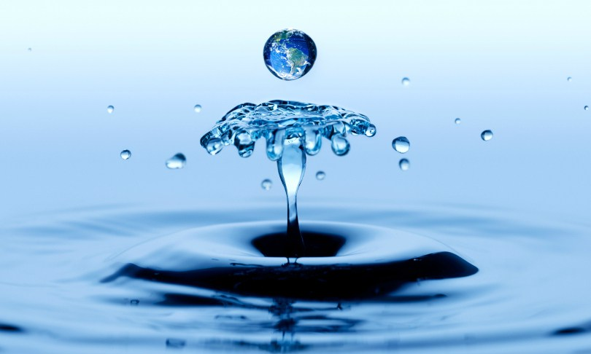
hydrosphere
All of the water that circulates through the Earth, including ice and water vapor, makes up the hydrosphere. The hydrosphere gives life to all of Earth’s organisms, and holds a part in the climate of the Earth. Without the water in the hydrosphere, temperatures and climate would change drastically, and affect the biosphere and atmosphere.

Slide 6
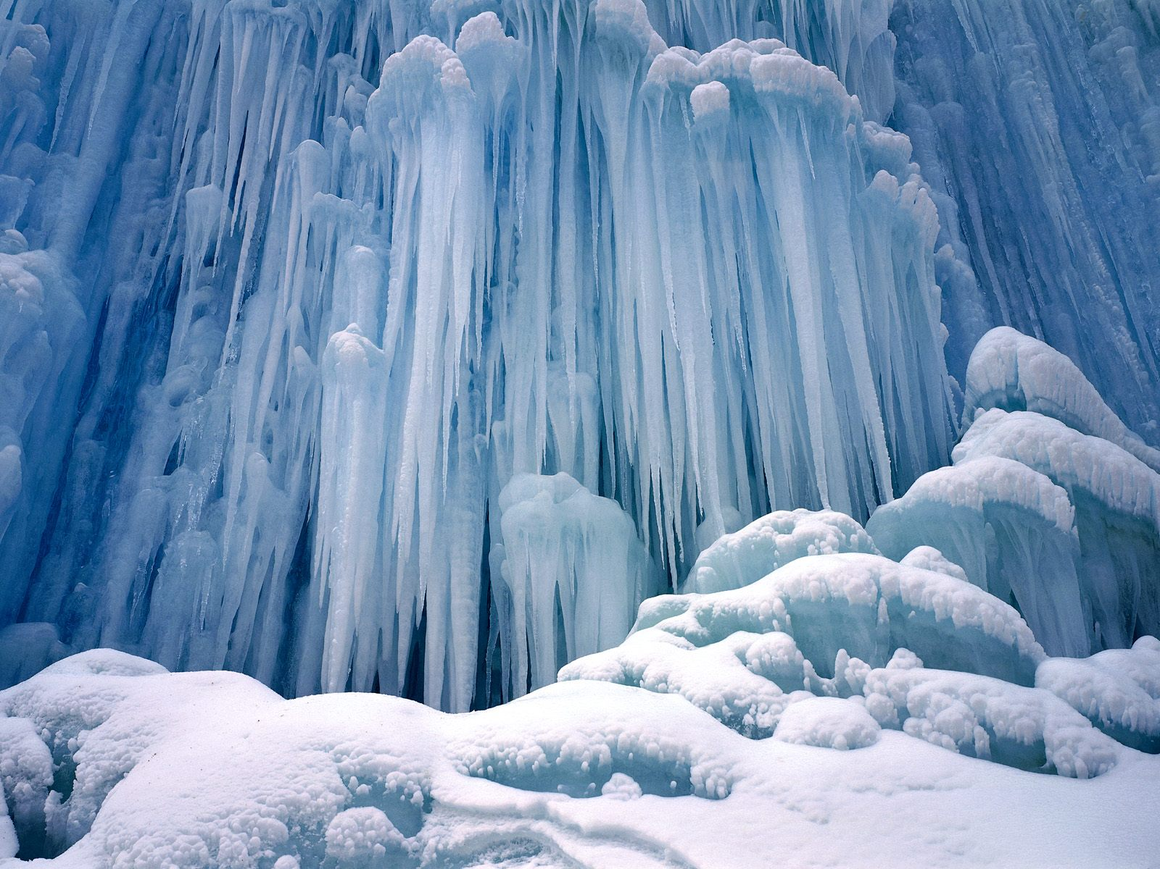
Cryosphere
The cryosphere is a fraction of the hydrosphere, and is all of the ice that makes up the hydrosphere. As with the hydrosphere, the cryosphere also helps regulate the climate and temperatures. Because of the snow and ice’s light white, it reflects sunlight which will cool the ground. Again, without the cryosphere, the biosphere and atmosphere would be affected.

Slide 7
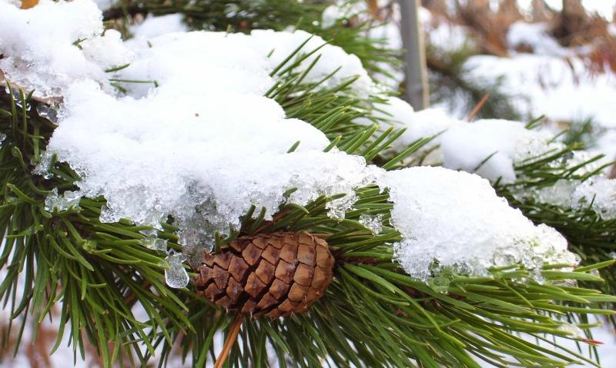
biosphere
The biosphere is made up of all living organisms on Earth. The biosphere depends on the other spheres to survive, the atmosphere for oxygen, and the hydrosphere and cryosphere for water.

Slide 8
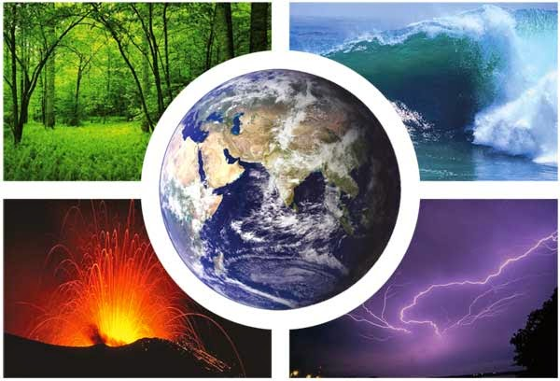
Feedback and interacting spheres
As changes in spheres occur, the system will give feedback. The feedback can be positive or negative, depending on the situation. For example, when ice melts, it causes the temperatures to rise. The spheres can also interact and cause changes to each other, both positively and negatively.

