Slide 1
Lesson 6.1
By: Mathew Abader , Nicholas Escalera., Nicholas King , Landon Weld , Kaleb Almendarez , Andromaxh Koutsouradis, and Jeremy Grey

Slide 2
Warning ! Pay attention

Slide 3
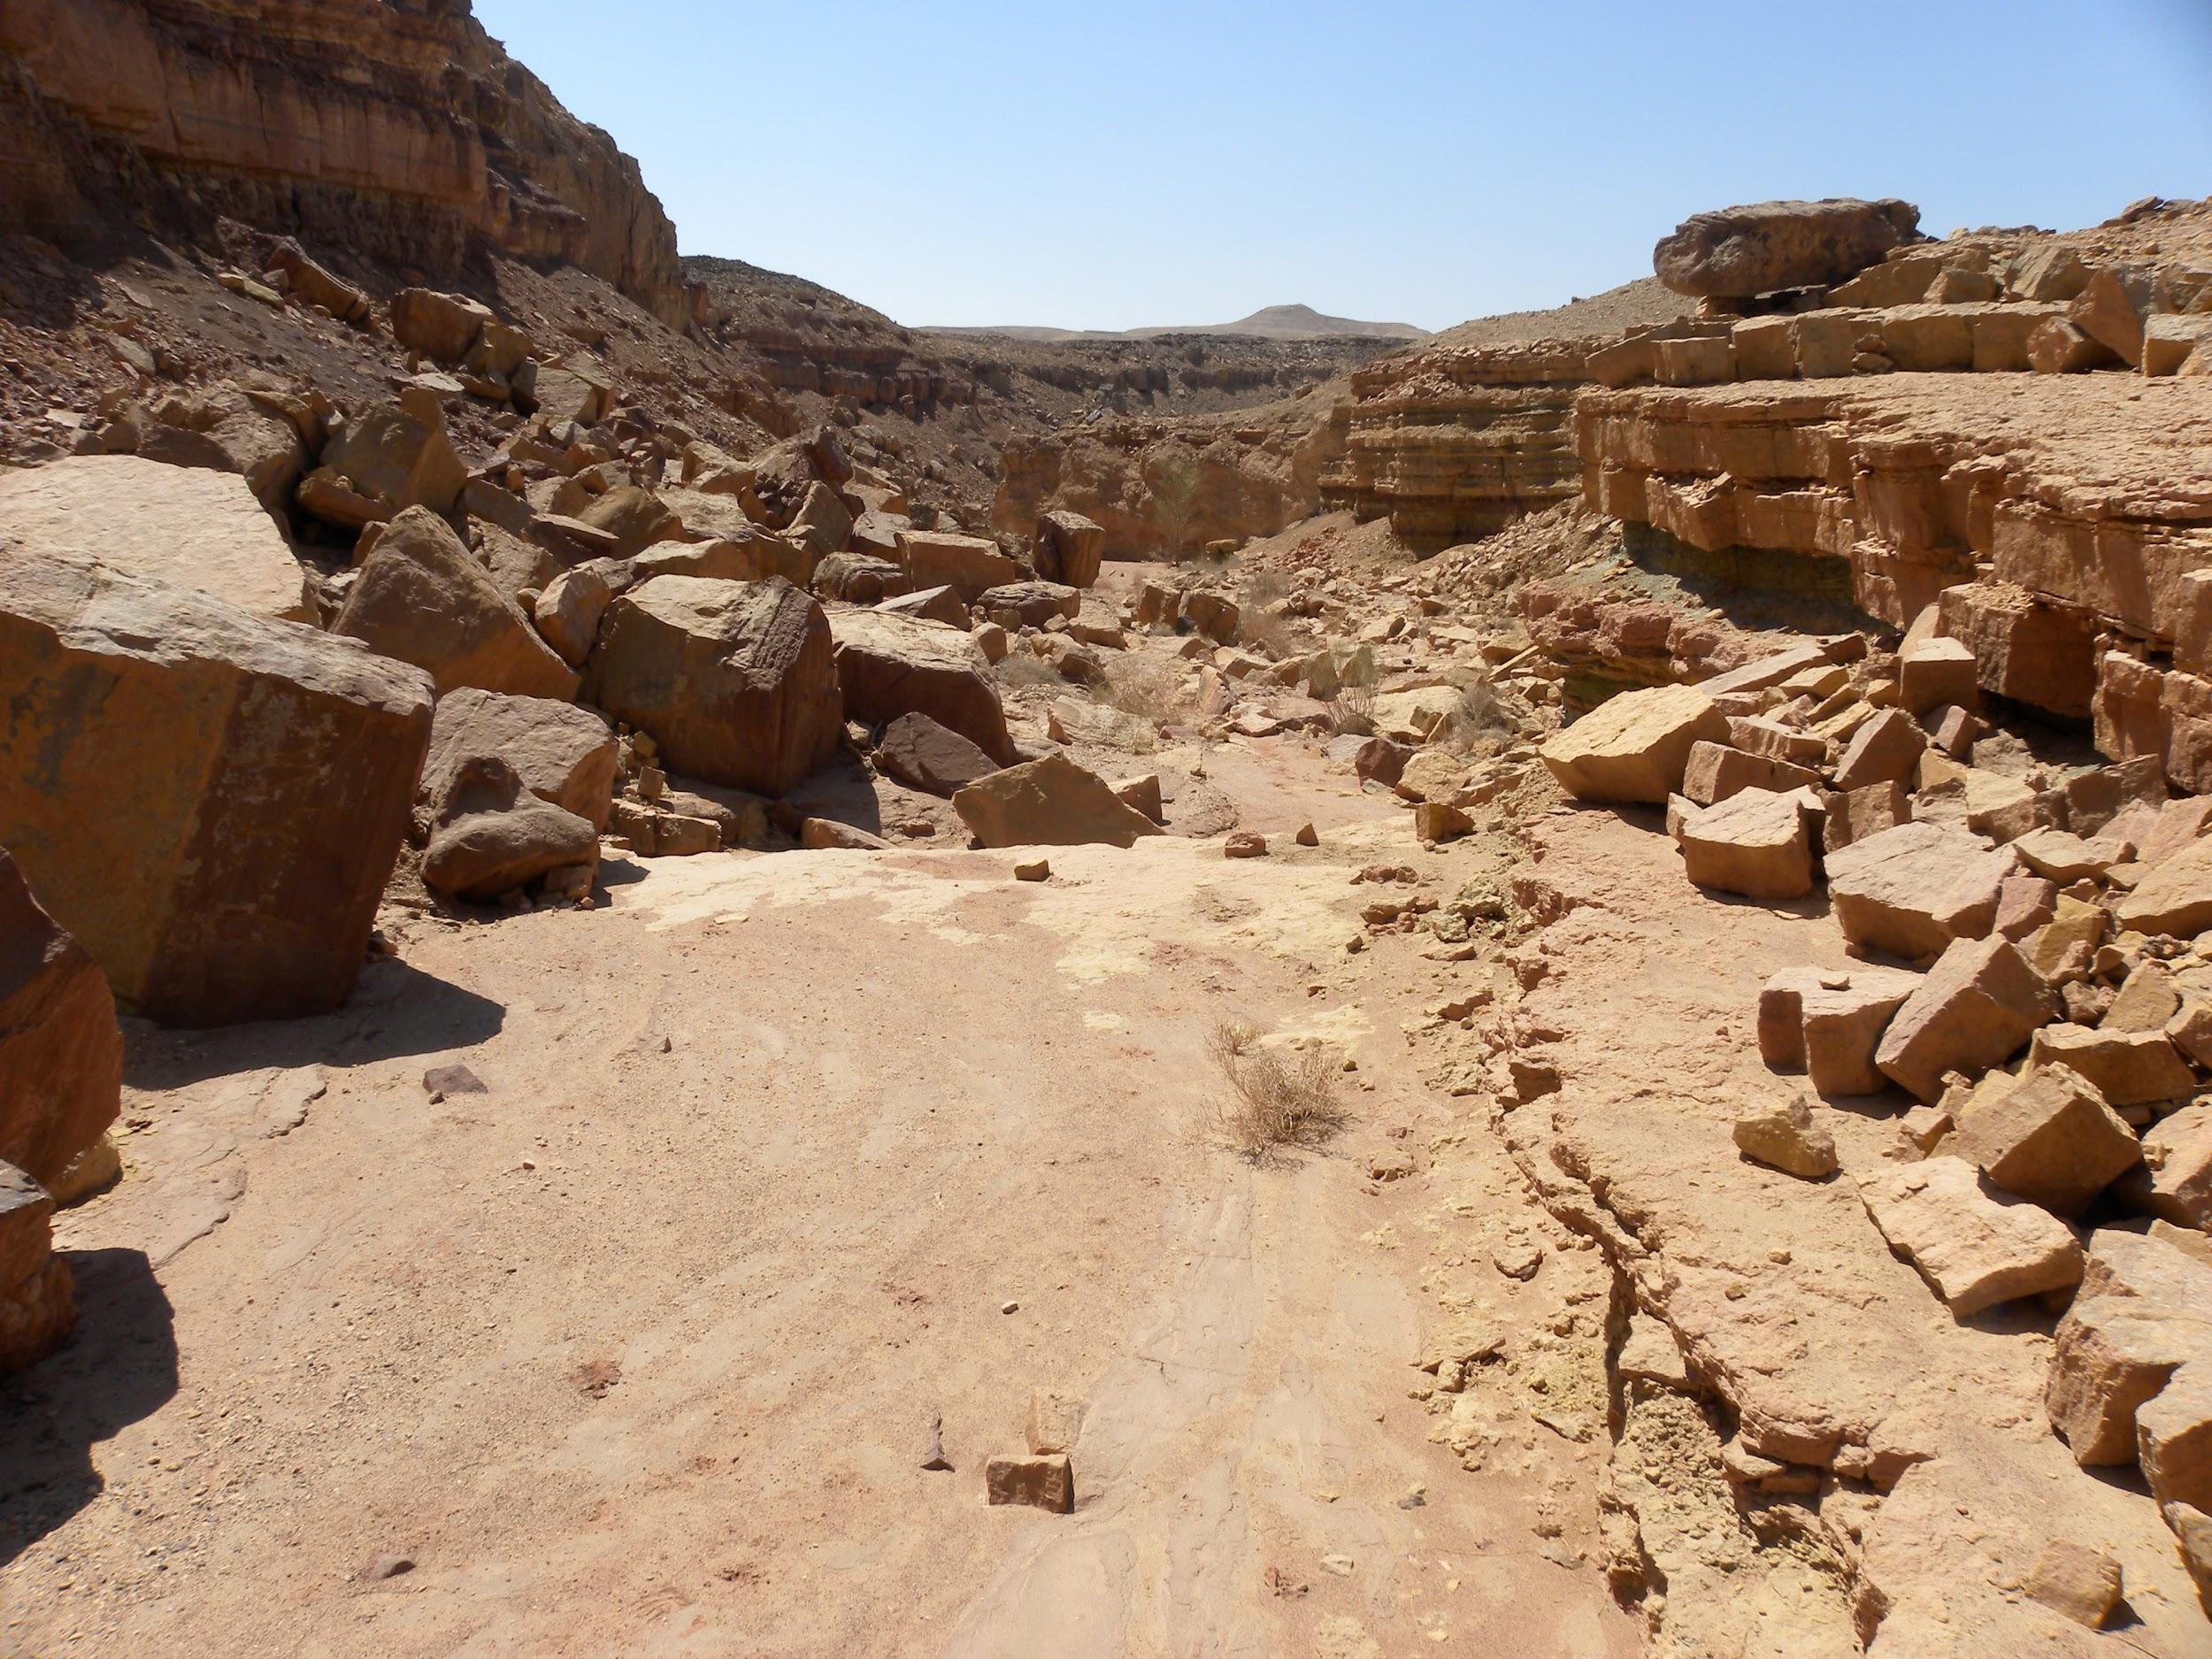
How does erosion change Earth’s surface?
Erosion changes Earth’s surface by moving all the rocks already weathered that are small pieces connecting it to make rocks that were transported to make canyons and little cliffs.

Slide 4
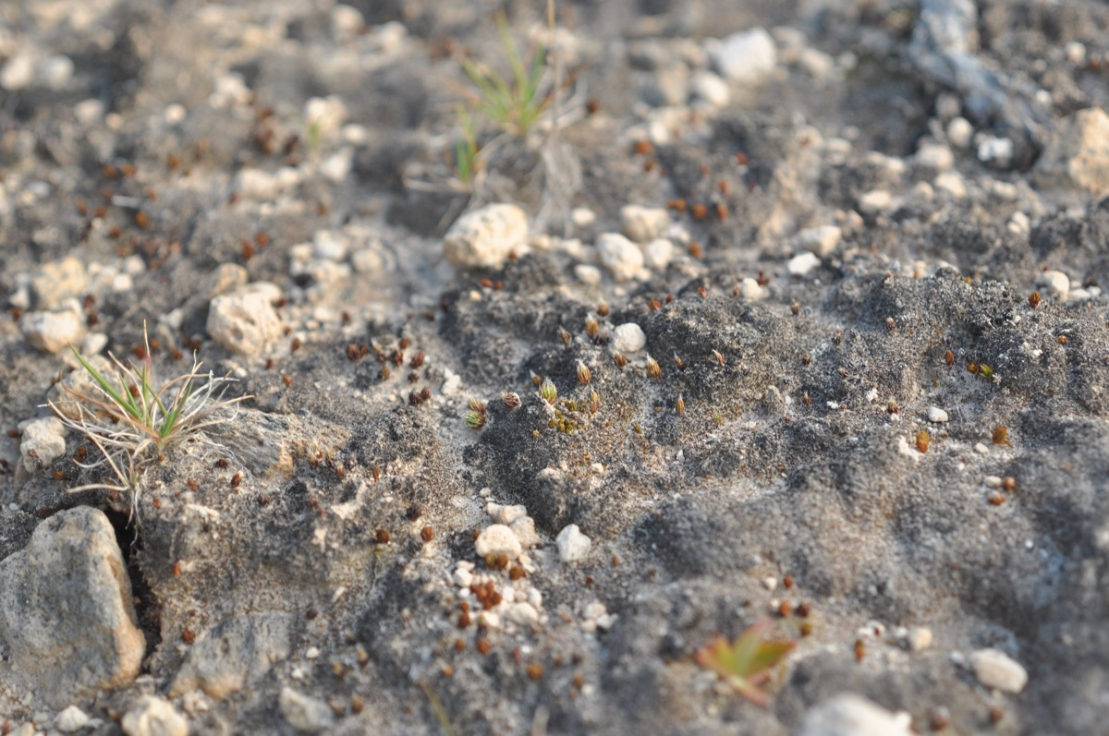
How does soil form?
Soil is formed as a rock that is weathered and mixes with the materials on the surface. Soil forms wherever bedrock weathers.

Slide 5
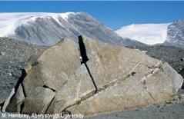
How does weathering change earth’s surface?
Weathering changes earth’s surface by wearing away surfaces of a rock then smoothing away rough parts of the rock and causing rock materials to break down. Weathering also creates soil by gathering rock particles that have previously broken down. This affects the earth because it breaks down rocks that could have been mountains and rock formations.

Slide 6
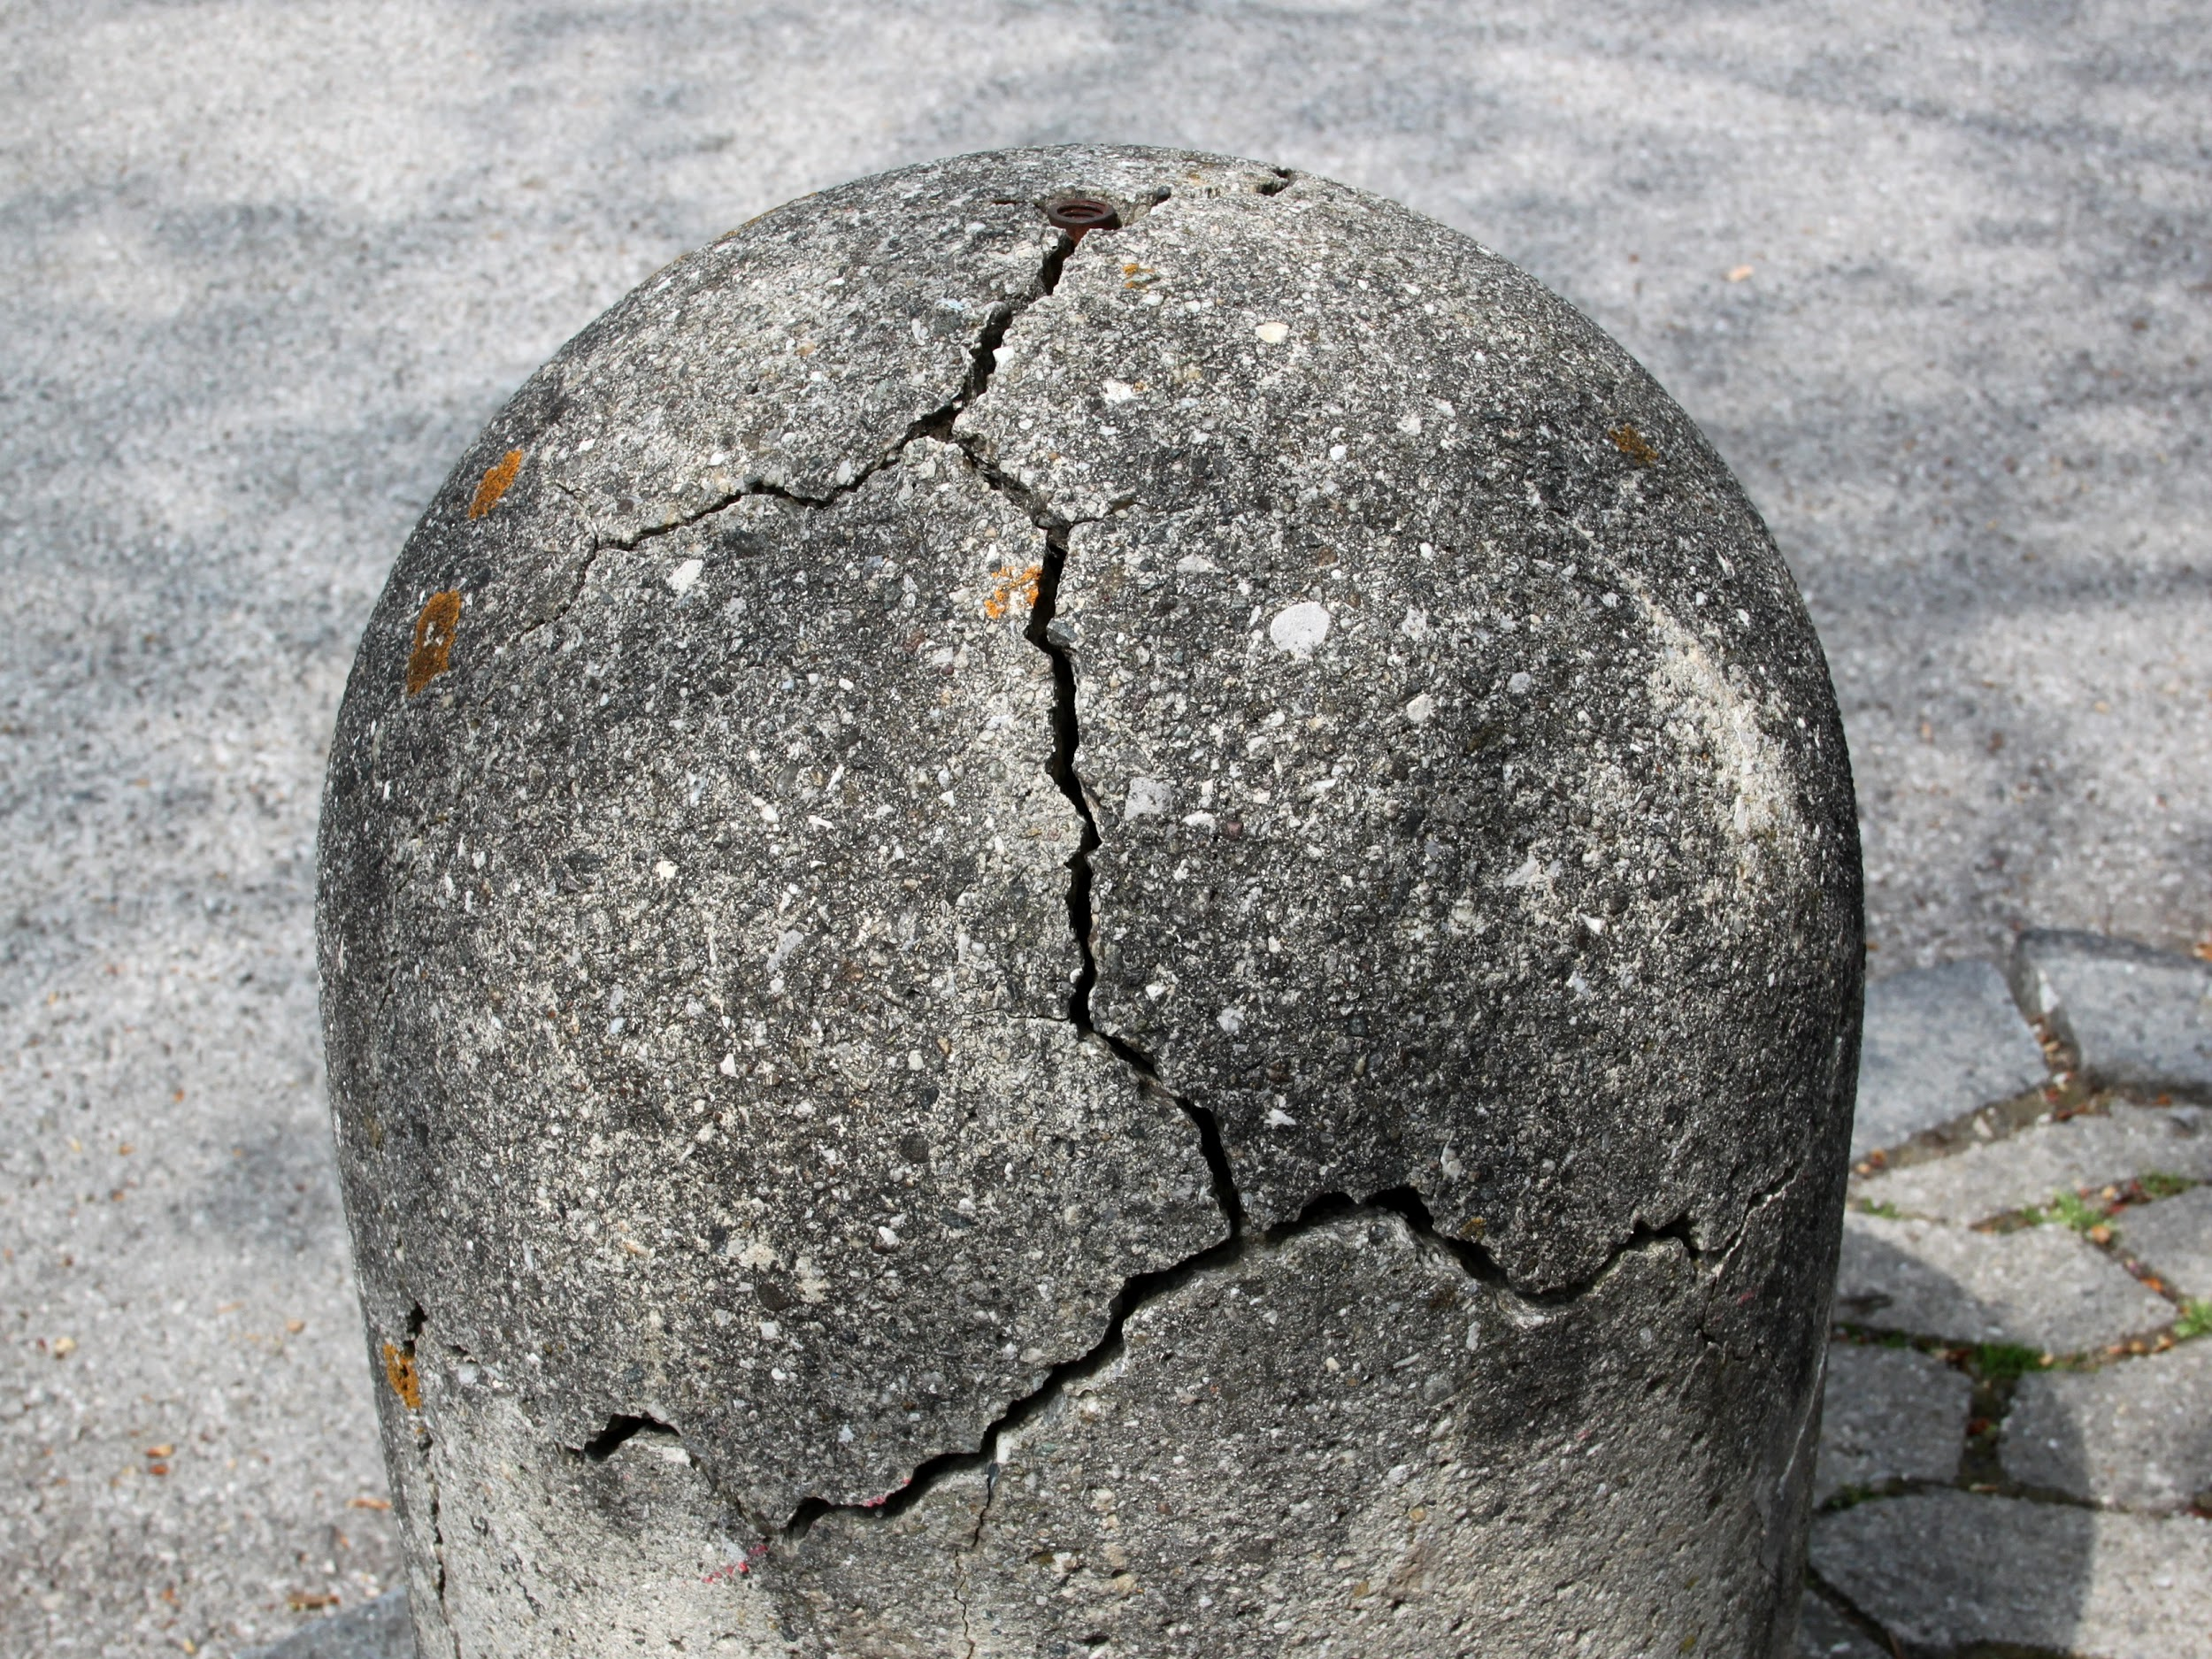
What is mechanical weathering?
Mechanical weathering is the process of a rock broken down to smaller pieces physically. Mechanical Weathering Happens over a long period of time.

Slide 7
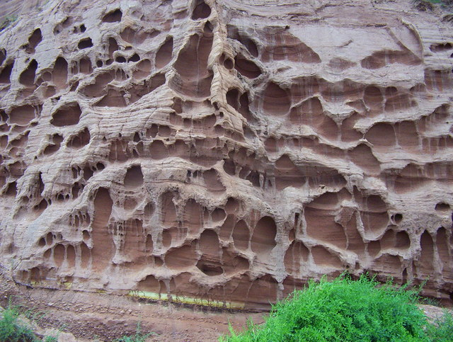
What is Chemical weathering?
Chemical weathering is the process at which breaks down rocks through chemical changes. Chemical weathering also produces minerals as it breaks down rocks.

Slide 8
Video
Erosion video
This video is a kid friendly video that helps kids learn all of the processes in a fun manner using cartoons and superheroes Breaker and Whoosh the video is made by schooltube.

Slide 9
Gimkit.com
And now we have a fun science game of 6 questions to see what you know from what our group!
Go to www.gimkit.com/play
WINNER GETS PLATOS

